Slide 1

ECFSPR 2024 ANNUAL DATA REPORT
SLIDE DECK
Citation:
Zolin, A., Adamoli, A., Zomer, D., Fox, A., Krasnyk, M., Lorca Mayor, S., Prasad, V., Gambazza, S., Orenti, A., Gkolia, P., Cook, E., Duckers, J., Jung, A., Laidlaw, K., Dubois, C., Kirwan, L., Krivec, U., Naehrlich, L., & Bakkeheim, E. (2026). ECFSPR 2024 Annual Data Report. Zenodo.
https://doi.org/10.5281/zenodo.20085096.
If you use the graph(s) to include in your presentation:
Include the citation above.
Consider the note(s) below the figures to interpret the information properly.
For information contact info@ecfregistry.eu
https://pr.ecfs.eu/

Slide 2
Index (Ctrl + Click to go directly to the slide)
CHAPTER 1: DEMOGRAPHICS
1.1 Map of countries that contributed data
1.2 Number of people with CF
1.3 Growth of the ECFSPR over time
1.4 Age distribution at follow-up
1.5 Proportion of adults with CF
1.6 Proportion of children and adults
CHAPTER 2: DIAGNOSIS
2.1 Proportion of children diagnosed at younger than 3 months or between 3 months and 18 years
2.2 Proportion of adults diagnosed at younger than 3 months or between 3 months and 18 years
2.3 Newborn screening in children 5 years old or younger
2.4 Meconium ileus at birth in children and adolescents
2.5 Newborn screening increase over time in children 5 years old or younger
CHAPTER 3: GENETICS
3.1 Prevalence of F508del variant and two class I variants
3.2 Distribution of the F508del variant on the map
3.3 Distribution of the G542X variant on the map
3.4 Distribution of the N130K variant on the map
3.5 Distribution of the G551D variant on the map
3.6 Distribution of the 2789+5G>A variant on the map
CHAPTER 4: LUNG FUNCTION
4.1 FEV1pp in children 6-11 years old
4.2 FEV1pp in adolescents 12-17 years old
4.3 FEV1pp in adults 18-39 years old
4.4 FEV1pp in adults aged 40 and older
4.5 Median FEV1pp by age group and by country
4.6 FEV1pp by severity in children 6-11 years old
4.7 FEV1pp by severity in adolescents 12-17 years old
4.8 FEV1pp by severity in young adults 18-39 years old
4.9 FEV1pp by severity in adults over 40
4.10 Median FEV1pp by age group over time
CHAPTER 5: MICROBIOLOGY
5.1 Chronic Pseudomonas aeruginosa
5.2 Chronic Burkholderia cepacia complex species
5.3 Prevalence of Haemophilus influenzae
5.4 Chronic Methicillin sensitive Staphylococcus aureus
5.5 Prevalence of Methicillin resistant Staphylococcus auerus
5.6 Prevalence of Stenotrophomonas maltophilia
5.7 Prevalence of Achromobacter species
5.8 Pseudomonas aeruginosa infection decrease over time
5.9 Methicillin sensitive Staphylococcus aureus
infection decrease over time
CHAPTER 6: NUTRITION
6.1 Use of pancreatic enzymes
6.2 Median BMI z-score for children and adolescents 2-17 years old, by country
6.3 Proportion of children and adolescents 2–17 years old who are underweight, by sex and by country
6.4 Proportion of adults 18 and older with BMI<20, by sex and by country
6.5 Median z-score for BMI by age group in 2014, 2019 and 2024
CHAPTER 7: COMPLICATIONS
7.1 Prevalence of at least 1 day on IV antibiotics at home and/or hospital in children and adults, by country
7.2 Prevalence of at least 1 day in hospital in children and adults, by country
CHAPTER 8: THERAPIES
8.1 Use of inhaled hypertonic saline
8.2 Use of rhDNase
8.3 Use of inhaled antibiotics
8.4 Use of bronchodilators
8.5 Use of macrolides
8.6 Use of inhaled steroids
8.7 Use of oral steroids
8.8 Use of ursodeoxycholic acid
8.9 Use of proton pump inhibitors
8.10 CFTR modulator & other medication in children and adolescents over time
8.11 CFTR modulator & other medication in adults over time
CHAPTER 9: CFTR MODULATOR THERAPIES
9.1 Ivacaftor
9.2 Lumacaftor/ivacaftor
9.3 Tezacaftor/ivacaftor
9.4 Elexacaftor/tezacaftor/ivacaftor
9.5 Eligibility and use of CFTR modulators in children and adolescents
9.6 Eligibility and use of CFTR modulators in adults
9.7 Use of CFTR modulator therapy from 2018 to 2024
CHAPTER 10: PREGNANCY
10.1 Pregnancy and pregnancy outcomes in women (≥16 years) seen in 2024
10.2 Pregnancy and pregnancy outcomes in women (≥16 years) seen in 2023
CHAPTER 11: LUNG & OTHER ORGAN TRANSPLANTS
11.1 People living in 2024 with transplanted lungs
11.2 People living in 2024 with transplanted liver
CHAPTER 12: MORTALITY
12.1 Age at death distribution in 2024, by sex
12.2 Deceased PwCF from 2014 to 2024
CHAPTER 13: DATA QUALITY
13.1 Data completeness in follow-up year
2024
13.2 Data accuracy for the
follow-up years 2023 and 2024
https://pr.ecfs.eu/

Slide 3
CHAPTER 1 DEMOGRAPHICS
https://pr.ecfs.eu/

Slide 4

Figure 1.1
Map of countries that contributed data to the ECFSPR for the year 2024.
Note: BE could not provide data due to internal technical software issues and is marked in light blue.
The countries that contributed 2024 data are in turquoise.
Zolin, A., Adamoli, A., Zomer, D., Fox, A., Krasnyk, M., Lorca Mayor, S., Prasad, V., Gambazza, S., Orenti, A., Gkolia, P., Cook, E., Duckers, J., Jung, A., Laidlaw, K., Dubois, C., Kirwan, L., Krivec, U., Naehrlich, L., & Bakkeheim, E. (2026). ECFSPR 2024 Annual Data Report. Zenodo. https://doi.org/10.5281/zenodo.20085096

Slide 5
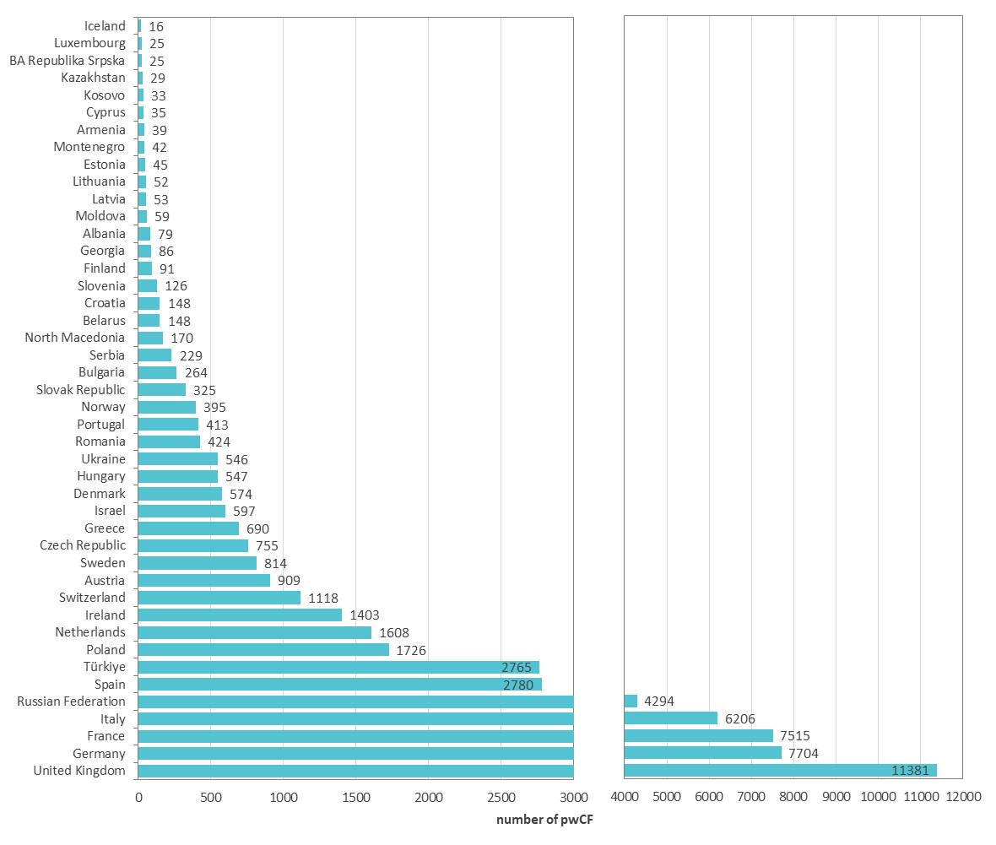
Figure 1.2
The number of people with CF registered in the ECFSPR varies across countries.
Number of people with CF registered in the ECFSR in 2024.
Note: The x-axis scales differ between the left and right panels.
Each bar shows the number of registered people with CF (excludes those lost to follow-up) living in that country in 2024. Please refer to table 1.1 in the ECFSPR 2024 Annual Data Report for the coverage in each country.
Zolin, A., Adamoli, A., Zomer, D., Fox, A., Krasnyk, M., Lorca Mayor, S., Prasad, V., Gambazza, S., Orenti, A., Gkolia, P., Cook, E., Duckers, J., Jung, A., Laidlaw, K., Dubois, C., Kirwan, L., Krivec, U., Naehrlich, L., & Bakkeheim, E. (2026). ECFSPR 2024 Annual Data Report. Zenodo. https://doi.org/10.5281/zenodo.20085096

Slide 6
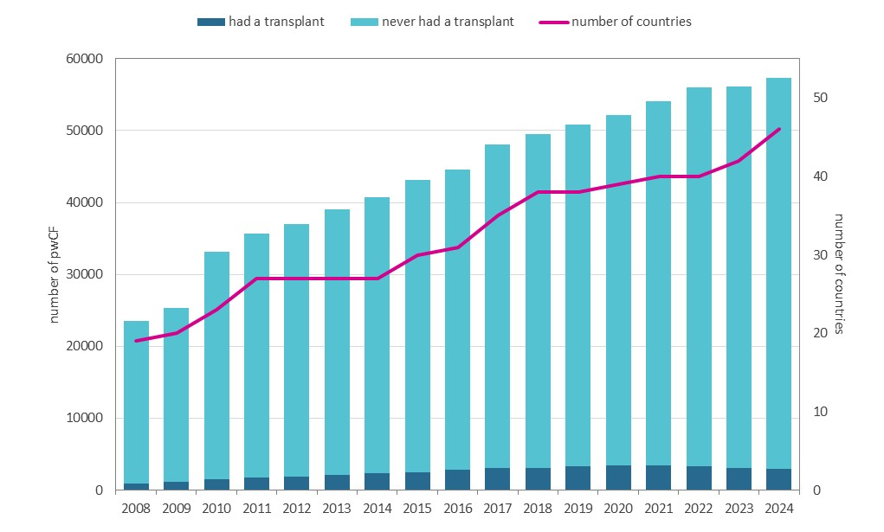
Figure 1.3
The number of countries and people with CF in the ECFSPR has risen continuously over the years.
Number of registered people with CF and number of countries from 2008 to 2024.
Figure 1.3 presents data over time using cross sectional data per year of people with a confirmed CF diagnosis. All people with CF alive and seen, deceased, or not seen but known to be alive during the year of follow-up were included.
Zolin, A., Adamoli, A., Zomer, D., Fox, A., Krasnyk, M., Lorca Mayor, S., Prasad, V., Gambazza, S., Orenti, A., Gkolia, P., Cook, E., Duckers, J., Jung, A., Laidlaw, K., Dubois, C., Kirwan, L., Krivec, U., Naehrlich, L., & Bakkeheim, E. (2026). ECFSPR 2024 Annual Data Report. Zenodo. https://doi.org/10.5281/zenodo.20085096

Slide 7
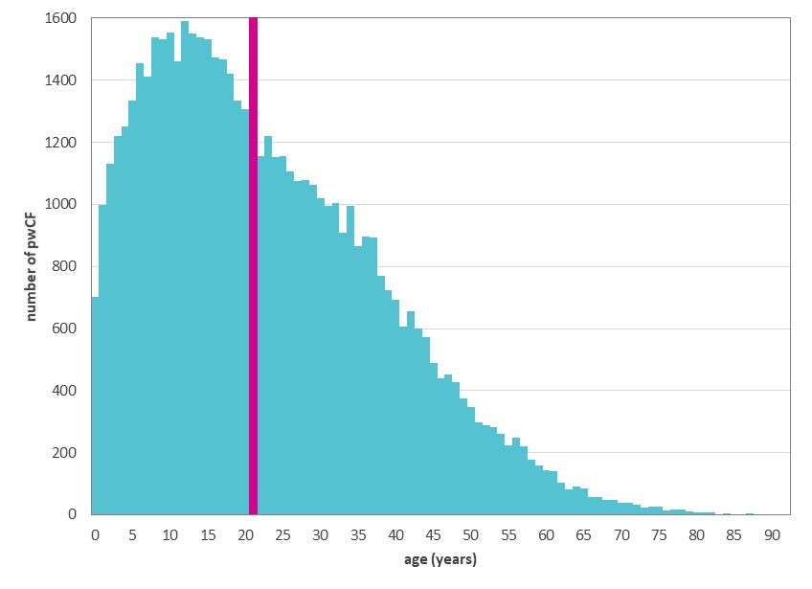
Figure 1.4
Age distribution demonstrates a sharp decline from the third decade of life.
Distribution of age at follow-up. Registered people with CF and alive on 31/12/2024.
Each vertical bar shows the number of people with CF of that age alive in 2024. The median age of PwCF for 2024 is 21 years; for 2019 and 2014 it was 19 years (Table A1.1, Appendix 1 in the ECFSPR 2024 Annual Data Report).
Zolin, A., Adamoli, A., Zomer, D., Fox, A., Krasnyk, M., Lorca Mayor, S., Prasad, V., Gambazza, S., Orenti, A., Gkolia, P., Cook, E., Duckers, J., Jung, A., Laidlaw, K., Dubois, C., Kirwan, L., Krivec, U., Naehrlich, L., & Bakkeheim, E. (2026). ECFSPR 2024 Annual Data Report. Zenodo. https://doi.org/10.5281/zenodo.20085096

Slide 8
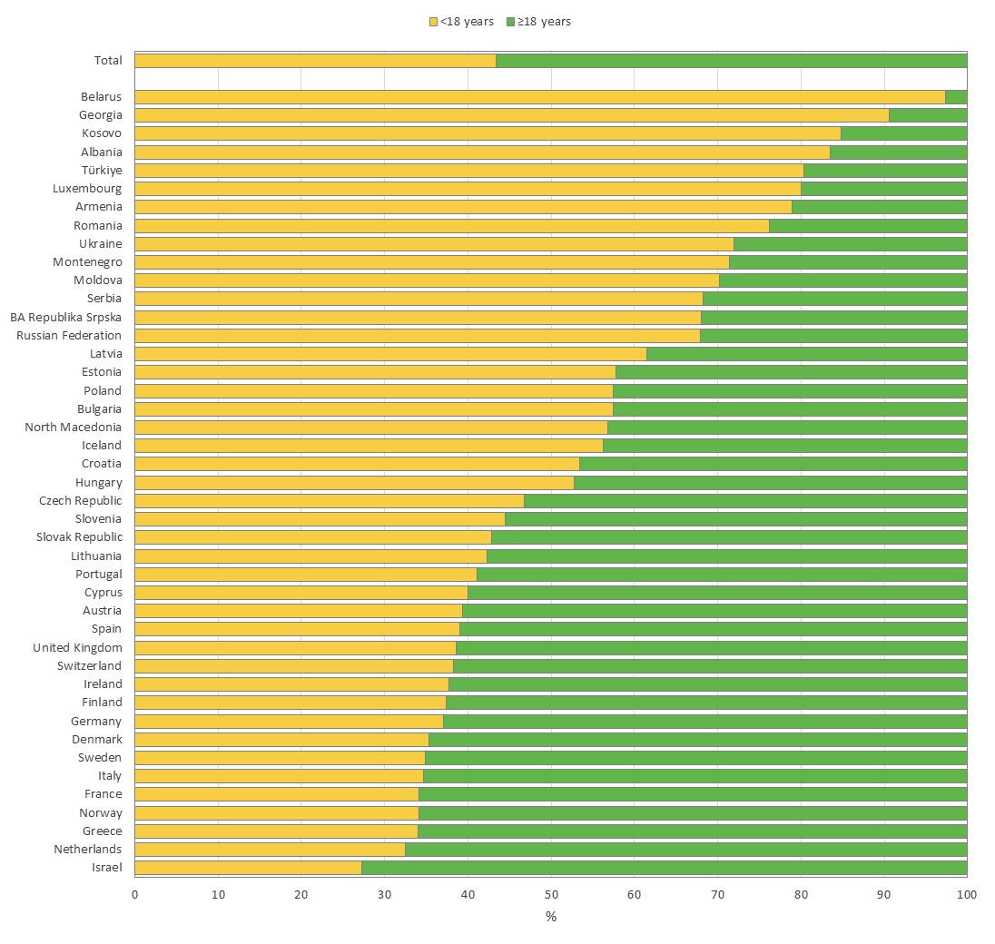
Figure 1.5
The proportion of adults with CF varies considerably between European countries.
Proportion of children and adolescents (<18 years) and adults (≥18 years), by country and overall. Registered people with CF alive on 31/12/2024.
Zolin, A., Adamoli, A., Zomer, D., Fox, A., Krasnyk, M., Lorca Mayor, S., Prasad, V., Gambazza, S., Orenti, A., Gkolia, P., Cook, E., Duckers, J., Jung, A., Laidlaw, K., Dubois, C., Kirwan, L., Krivec, U., Naehrlich, L., & Bakkeheim, E. (2026). ECFSPR 2024 Annual Data Report. Zenodo. https://doi.org/10.5281/zenodo.20085096

Slide 9
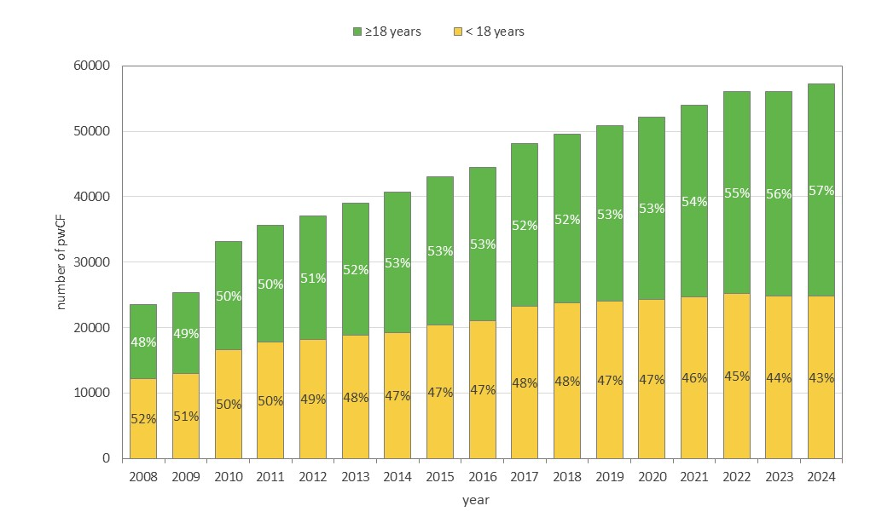
Figure 1.6
In recent years the proportion of adults with CF in Europe has risen significantly; as of 2024, adults made up 57% of the total.
Number of registered people with CF and percentage of adults and children/adolescents from 2008 to 2024.
This graph presents data over time using cross sectional data per year of people with a confirmed CF diagnosis. All people with CF alive and seen, deceased, or not seen but known to be alive during the year of follow-up were included.
Zolin, A., Adamoli, A., Zomer, D., Fox, A., Krasnyk, M., Lorca Mayor, S., Prasad, V., Gambazza, S., Orenti, A., Gkolia, P., Cook, E., Duckers, J., Jung, A., Laidlaw, K., Dubois, C., Kirwan, L., Krivec, U., Naehrlich, L., & Bakkeheim, E. (2026). ECFSPR 2024 Annual Data Report. Zenodo. https://doi.org/10.5281/zenodo.20085096

Slide 10
CHAPTER 2 DIAGNOSIS
https://pr.ecfs.eu/

Slide 11
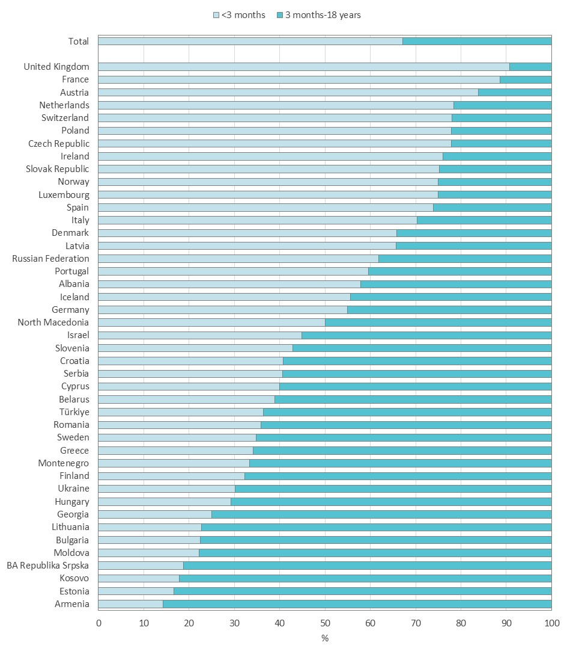
Figure 2.1
After the implementation of newborn screening programmes, 66% of children are diagnosed with CF before they are 3 months old.
Proportion of children diagnosed with CF at younger than 3 months, between 3 months and 18 years, by country and overall. All children and adolescents with CF seen by a clinician in 2024.
Note: For Cyprus and Greece, the information on age at diagnosis is missing for more than 10% of the people with CF.
Zolin, A., Adamoli, A., Zomer, D., Fox, A., Krasnyk, M., Lorca Mayor, S., Prasad, V., Gambazza, S., Orenti, A., Gkolia, P., Cook, E., Duckers, J., Jung, A., Laidlaw, K., Dubois, C., Kirwan, L., Krivec, U., Naehrlich, L., & Bakkeheim, E. (2026). ECFSPR 2024 Annual Data Report. Zenodo. https://doi.org/10.5281/zenodo.20085096

Slide 12
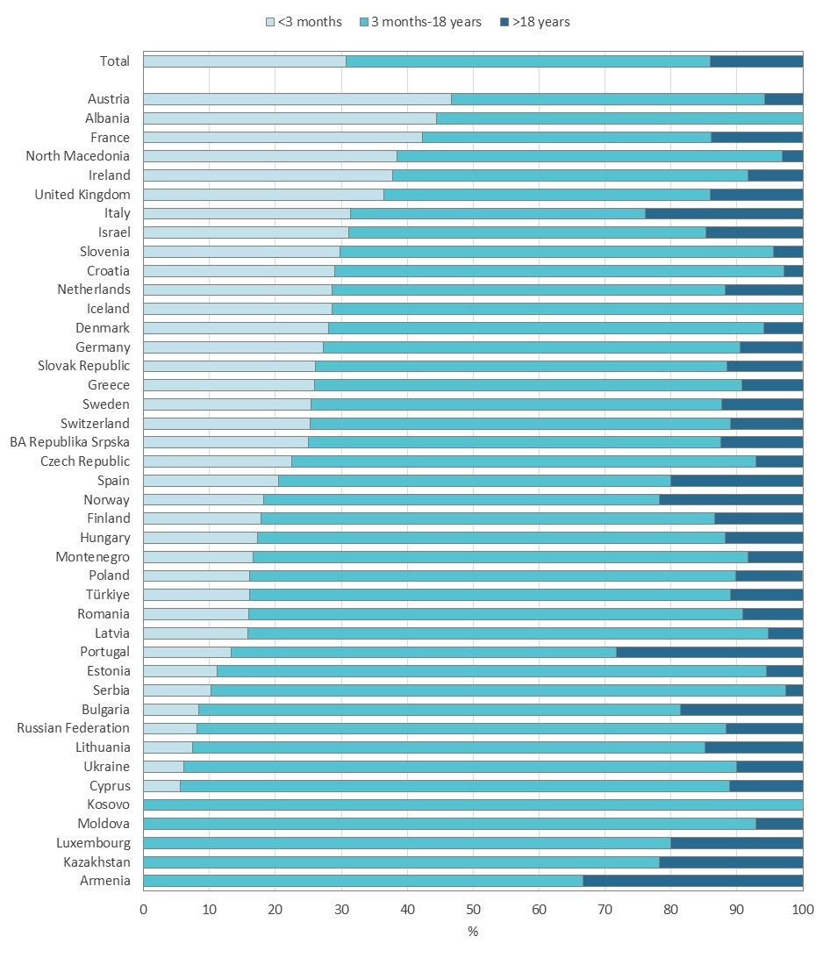
Figure 2.2
The age at diagnosis for those who are now adults has shifted to the first 3 months of life in many countries.
Proportion of adults with CF diagnosed at younger than 3 months, between 3 months and 18 years, and older than 18 years, by country and overall. All adults with CF seen by a clinician in 2024.
Note: Belarus and Georgia have <5 adults seen in 2024 and both countries are excluded form the table, but the people are included in the total number.
Note: For Austria, Cyprus, Greece and Switzerland the information on age at diagnosis is missing for more than 10% of the people with CF.
Zolin, A., Adamoli, A., Zomer, D., Fox, A., Krasnyk, M., Lorca Mayor, S., Prasad, V., Gambazza, S., Orenti, A., Gkolia, P., Cook, E., Duckers, J., Jung, A., Laidlaw, K., Dubois, C., Kirwan, L., Krivec, U., Naehrlich, L., & Bakkeheim, E. (2026). ECFSPR 2024 Annual Data Report. Zenodo. https://doi.org/10.5281/zenodo.20085096

Slide 13
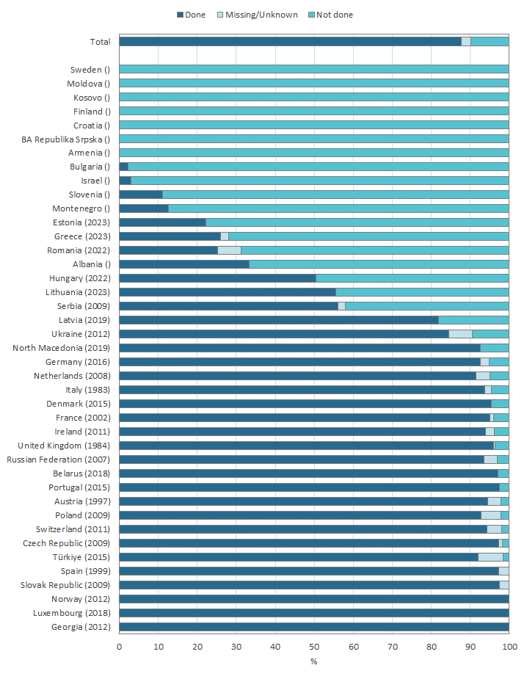
Figure 2.3
More than 85% of the young children with CF who were in the ECFSPR in 2024 underwent newborn screening.
Proportion of children with CF who underwent neonatal screening, by country (year of NBS program start) and overall. Children 5 years old or younger and seen by a clinician in 2024.
Note: Cyprus and Iceland have <5 children who were 5 years old or younger and seen by a clinician in 2024 and both countries are excluded from the graph.
Note: Where there is no year in brackets after the country name the country did not have an NBS programme as of 2024.
Note: For Italy, Netherlands, Serbia, Spain, Ukraine and the United Kingdom the year in brackets corresponds to the start of the first regional NBS programme.
Note: For France and the United Kingdom positive answers (“neonatal screening done”) are reported only when neonatal screening is one of the factors that led to CF diagnosis.
Zolin, A., Adamoli, A., Zomer, D., Fox, A., Krasnyk, M., Lorca Mayor, S., Prasad, V., Gambazza, S., Orenti, A., Gkolia, P., Cook, E., Duckers, J., Jung, A., Laidlaw, K., Dubois, C., Kirwan, L., Krivec, U., Naehrlich, L., & Bakkeheim, E. (2026). ECFSPR 2024 Annual Data Report. Zenodo. https://doi.org/10.5281/zenodo.20085096

Slide 14
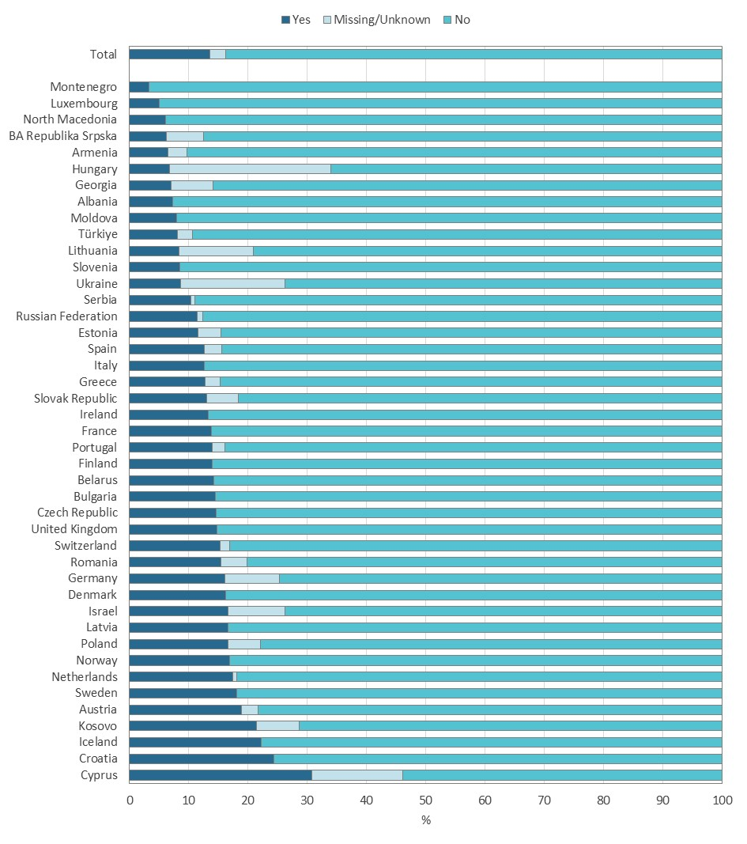
Figure 2.4
Meconium ileus at birth is not rare and may be the first symptom of CF detected in newborns.
Children and adolescents with CF who had meconium ileus at birth, by country and overall. All children and adolescents with CF seen by a clinician in 2024.
Note: For Cyprus, Hungary, Lithuania and Ukraine, the information on meconium ileus is missing for more than 10% of the children and adolescents
Zolin, A., Adamoli, A., Zomer, D., Fox, A., Krasnyk, M., Lorca Mayor, S., Prasad, V., Gambazza, S., Orenti, A., Gkolia, P., Cook, E., Duckers, J., Jung, A., Laidlaw, K., Dubois, C., Kirwan, L., Krivec, U., Naehrlich, L., & Bakkeheim, E. (2026). ECFSPR 2024 Annual Data Report. Zenodo. https://doi.org/10.5281/zenodo.20085096

Slide 15
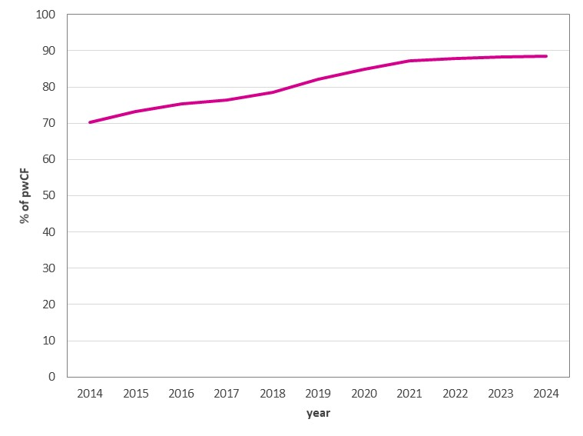
Figure 2.5
In the last decade, the proportion of children diagnosed with CF through newborn screening has increased to almost 90% in Europe.
Neonatal screening in children diagnosed with CF who were 5 years old or younger in the years from 2014 to 2024.
In this graph data over time are presented using cross sectional data per year of children with a confirmed CF diagnosis. Children with CF who are alive and seen by a clinician, deceased, or not seen during the year of follow-up were included; those who were lost to follow-up and/or had transplanted lung/s and/or liver were excluded.
Zolin, A., Adamoli, A., Zomer, D., Fox, A., Krasnyk, M., Lorca Mayor, S., Prasad, V., Gambazza, S., Orenti, A., Gkolia, P., Cook, E., Duckers, J., Jung, A., Laidlaw, K., Dubois, C., Kirwan, L., Krivec, U., Naehrlich, L., & Bakkeheim, E. (2026). ECFSPR 2024 Annual Data Report. Zenodo. https://doi.org/10.5281/zenodo.20085096

Slide 16
CHAPTER 3 GENETICS
https://pr.ecfs.eu/

Slide 17
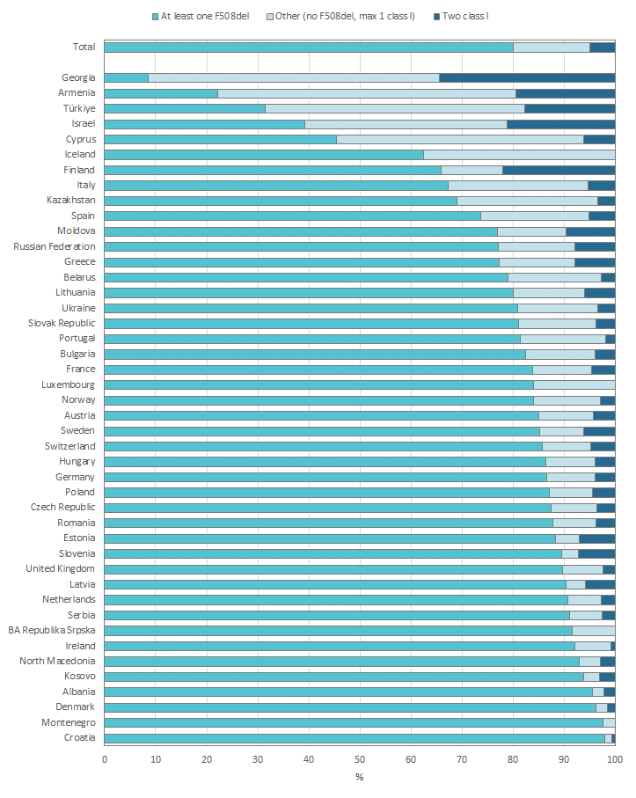
Figure 3.1
The prevalence of the F508del variant ant two class I variants vary considerable between the countries in Europe.
Prevalence of the F508del variant and two class I variants in people with CF, by country and overall. All people with CF seen in 2024.
Zolin, A., Adamoli, A., Zomer, D., Fox, A., Krasnyk, M., Lorca Mayor, S., Prasad, V., Gambazza, S., Orenti, A., Gkolia, P., Cook, E., Duckers, J., Jung, A., Laidlaw, K., Dubois, C., Kirwan, L., Krivec, U., Naehrlich, L., & Bakkeheim, E. (2026). ECFSPR 2024 Annual Data Report. Zenodo. https://doi.org/10.5281/zenodo.20085096

Slide 18
Figure 3.2
The allelic frequency of F508del variant is higher in Central Europe.
Geographical distribution of the F508del variant. All people with CF seen in 2024.
Note: Bosnia-Herzegovina and Kyrgyzstan are not “Not participating”, but their data are omitted because <5 PwCF were reported.
F508del is the most common variant in all countries; the highest allele frequency in the 2024 ECFSPR data occurs in BA-Republika Srpska (85.4%), followed by Denmark (85.6%) and Kosovo (81.8%).
Zolin, A., Adamoli, A., Zomer, D., Fox, A., Krasnyk, M., Lorca Mayor, S., Prasad, V., Gambazza, S., Orenti, A., Gkolia, P., Cook, E., Duckers, J., Jung, A., Laidlaw, K., Dubois, C., Kirwan, L., Krivec, U., Naehrlich, L., & Bakkeheim, E. (2026). ECFSPR 2024 Annual Data Report. Zenodo. https://doi.org/10.5281/zenodo.20085096

Slide 19
Figure 3.3
The G542X variant is more prevalent in Southern Europe.
Geographical distribution of the G542X variant. All people with CF seen in 2024.
Note: Bosnia-Herzegovina and Kyrgyzstan are not “Not participating”, but their data are omitted because <5 PwCF were reported.
The G542X variant is more common in Southern Europe, with the highest allele frequency being in Montenegro (14.3%), whereas it is very rarely found in Ireland, the Scandinavian countries or the Russian Federation.
Zolin, A., Adamoli, A., Zomer, D., Fox, A., Krasnyk, M., Lorca Mayor, S., Prasad, V., Gambazza, S., Orenti, A., Gkolia, P., Cook, E., Duckers, J., Jung, A., Laidlaw, K., Dubois, C., Kirwan, L., Krivec, U., Naehrlich, L., & Bakkeheim, E. (2026). ECFSPR 2024 Annual Data Report. Zenodo. https://doi.org/10.5281/zenodo.20085096

Slide 20
Figure 3.4
The N1303K variant is more prevalent in Southern and Eastern Europe.
Geographical distribution of the N1303K variant. All people with CF seen in 2024.
Note: Bosnia-Herzegovina and Kyrgyzstan are not “Not participating”, but their data are omitted because <5 PwCF were reported.
The N1303K variant is most frequent in Iceland (40.6%). This is an exception in Northern Europe where it is otherwise rare; it is much more frequent in the countries of Southern and Eastern Europe.
Zolin, A., Adamoli, A., Zomer, D., Fox, A., Krasnyk, M., Lorca Mayor, S., Prasad, V., Gambazza, S., Orenti, A., Gkolia, P., Cook, E., Duckers, J., Jung, A., Laidlaw, K., Dubois, C., Kirwan, L., Krivec, U., Naehrlich, L., & Bakkeheim, E. (2026). ECFSPR 2024 Annual Data Report. Zenodo. https://doi.org/10.5281/zenodo.20085096

Slide 21
Figure 3.5
The G551D variant is more frequent in the northern and central regions of Europe.
Geographical distribution of the G551D variant. All people with CF seen in 2024.
Note: Bosnia-Herzegovina and Kyrgyzstan are not “Not participating”, but their data are omitted because <5 PwCF were reported.
The G551D is most frequent in Ireland (8.3%) and in northern and central regions of Europe but rare in the rest of Europe.
Zolin, A., Adamoli, A., Zomer, D., Fox, A., Krasnyk, M., Lorca Mayor, S., Prasad, V., Gambazza, S., Orenti, A., Gkolia, P., Cook, E., Duckers, J., Jung, A., Laidlaw, K., Dubois, C., Kirwan, L., Krivec, U., Naehrlich, L., & Bakkeheim, E. (2026). ECFSPR 2024 Annual Data Report. Zenodo. https://doi.org/10.5281/zenodo.20085096

Slide 22
Figure 3.6
The 2789+5G->A variant is more common in Türkiye and the southern regions of Europe.
Geographical distribution of the 2789+5G->A variant. All people with CF seen in 2024.
Note: Bosnia-Herzegovina and Kyrgyzstan are not “Not participating”, but their data are omitted because <5 PwCF were reported.
The 2789+5G->A variant is most frequent in Armenia (4.2%) and in Southern Europe, and less common in Eastern Europe.
Zolin, A., Adamoli, A., Zomer, D., Fox, A., Krasnyk, M., Lorca Mayor, S., Prasad, V., Gambazza, S., Orenti, A., Gkolia, P., Cook, E., Duckers, J., Jung, A., Laidlaw, K., Dubois, C., Kirwan, L., Krivec, U., Naehrlich, L., & Bakkeheim, E. (2026). ECFSPR 2024 Annual Data Report. Zenodo. https://doi.org/10.5281/zenodo.20085096

Slide 23
CHAPTER 4 LUNG FUNCTION
https://pr.ecfs.eu/

Slide 24
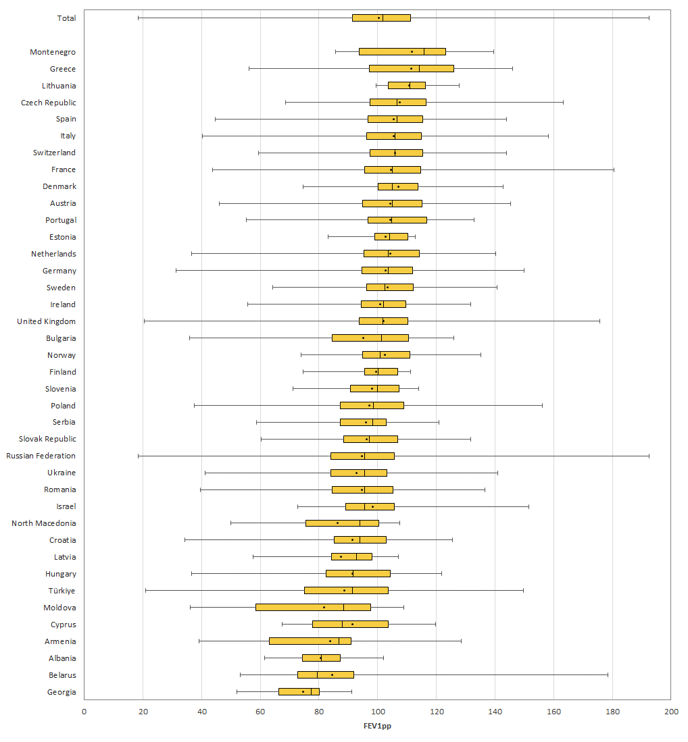
Figure 4.1
The median FEV1% of predicted is >90% for children with CF (between 6 and 11 years of age) in almost all countries in Europe.
FEV1pp: boxplot by country. Children with CF aged 6-11 years who have never had a transplant, seen by a clinician in 2024.
Note: BA-Republika Srpska, Iceland, Kazakhstan, Kosovo and Luxembourg have <5 individuals aged 6-11 years at the date of FEV1 and the countries are excluded from the graph.
Note: For Albania, Belarus, Cyprus, Georgia, Latvia, Moldova, North Macedonia, Romania, Serbia, the Russian Federation, Türkiye and Ukraine no FEV1 value was reported for more than 10% of the people with CF in the 6-11 year old age group.
Note: Sweden reported the FEV1 of the best FEV1pp in the 12 months prior to the annual review; this means the value could be from 2023 or 2024. The UK reported the EFEV1 of the best FEV1pp from the period between annual reviews. This also means that the value could be from 2023 or 2024.
Zolin, A., Adamoli, A., Zomer, D., Fox, A., Krasnyk, M., Lorca Mayor, S., Prasad, V., Gambazza, S., Orenti, A., Gkolia, P., Cook, E., Duckers, J., Jung, A., Laidlaw, K., Dubois, C., Kirwan, L., Krivec, U., Naehrlich, L., & Bakkeheim, E. (2026). ECFSPR 2024 Annual Data Report. Zenodo. https://doi.org/10.5281/zenodo.20085096

Slide 25
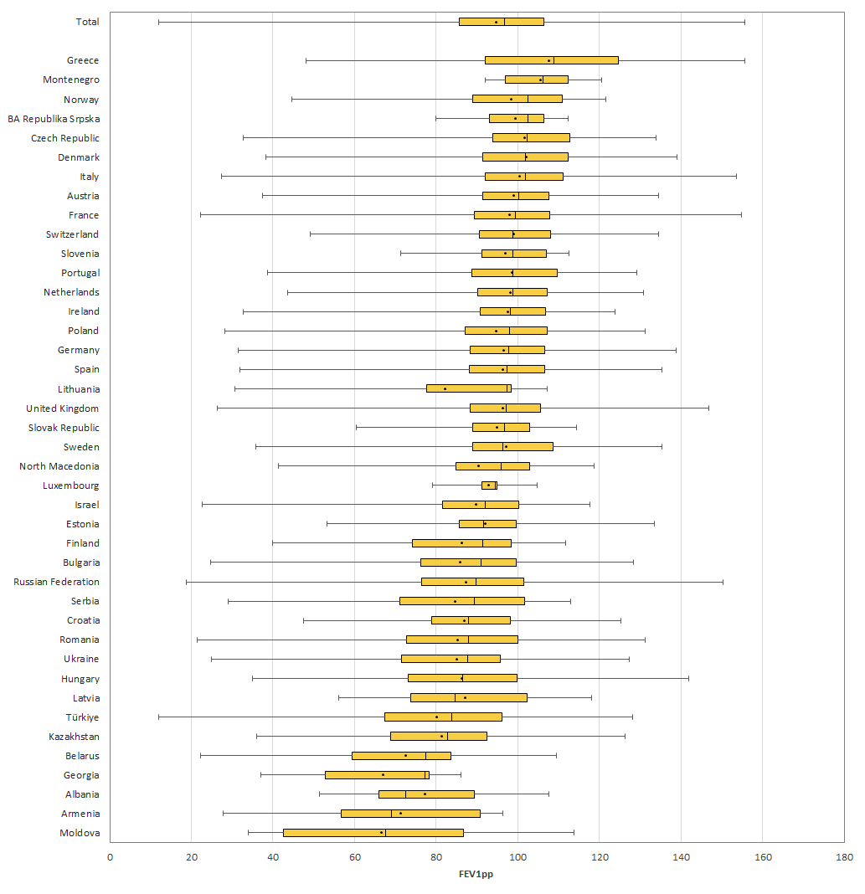
Figure 4.2
The median FEV1% of predicted is >80% for adolescents with CF (between 12 and 17 years of age) in almost all countries in Europe.
FEV1pp: boxplot by country. Adolescents with CF aged 12-17 years who have never had a transplant, seen by a clinician in 2024.
Note: Cyprus, Iceland and Kosovo have <5 individuals aged 12-17 years at the date of FEV1 and the countries are excluded from the graph.
Note: For Belarus, Georgia, Lithuania, the Russian Federation, Türkiye and Ukraine no FEV1 value was reported for more than 10% of the people with CF in the 12-17 year old age group.
Note: Sweden reported the FEV1 of the best FEV1pp in the 12 months prior to the annual review which means that the value could be from 2023 or 2024. The UK reported the EFEV1 of the best FEV1pp from the period between annual reviews, which also means that the value could be from 2023 or 2024.
Zolin, A., Adamoli, A., Zomer, D., Fox, A., Krasnyk, M., Lorca Mayor, S., Prasad, V., Gambazza, S., Orenti, A., Gkolia, P., Cook, E., Duckers, J., Jung, A., Laidlaw, K., Dubois, C., Kirwan, L., Krivec, U., Naehrlich, L., & Bakkeheim, E. (2026). ECFSPR 2024 Annual Data Report. Zenodo. https://doi.org/10.5281/zenodo.20085096

Slide 26
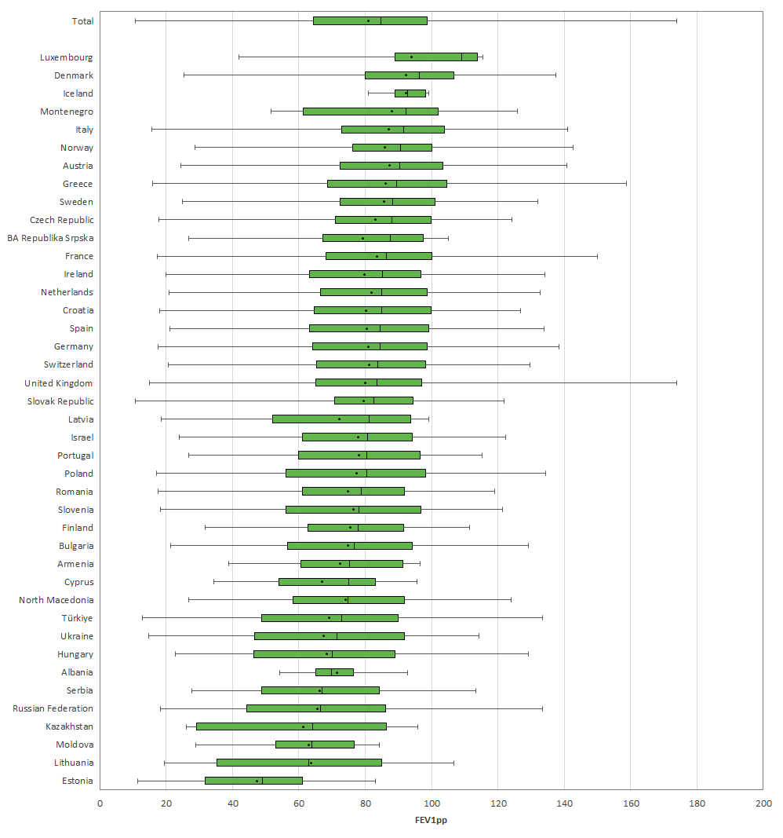
Figure 4.3
The median FEV1% of predicted for adults with CF (between 18 and 39 years of age) varies between 50% and 110% depending on the country.
FEV1pp: boxplot by country. Adults with CF who have never had a transplant, seen by a clinician in 2024.
Note: Belarus, Georgia and Kosovo have <5 individuals aged 18-39 years at the date of FEV1 measurement and the countries are excluded from the graph.
Note: For Moldova, the Russian Federation and Ukraine no FEV1 value was reported for more than 10% of the people with CF aged between 18 and 39.
Note: Sweden reported the FEV1 of the best FEV1pp in the 12 months prior to the annual review which means that the value could be from 2023 or 2024. The UK reported the EFEV1 of the best FEV1pp from the period between annual reviews, which also means that the value could be from 2023 or 2024.
Zolin, A., Adamoli, A., Zomer, D., Fox, A., Krasnyk, M., Lorca Mayor, S., Prasad, V., Gambazza, S., Orenti, A., Gkolia, P., Cook, E., Duckers, J., Jung, A., Laidlaw, K., Dubois, C., Kirwan, L., Krivec, U., Naehrlich, L., & Bakkeheim, E. (2026). ECFSPR 2024 Annual Data Report. Zenodo. https://doi.org/10.5281/zenodo.20085096

Slide 27
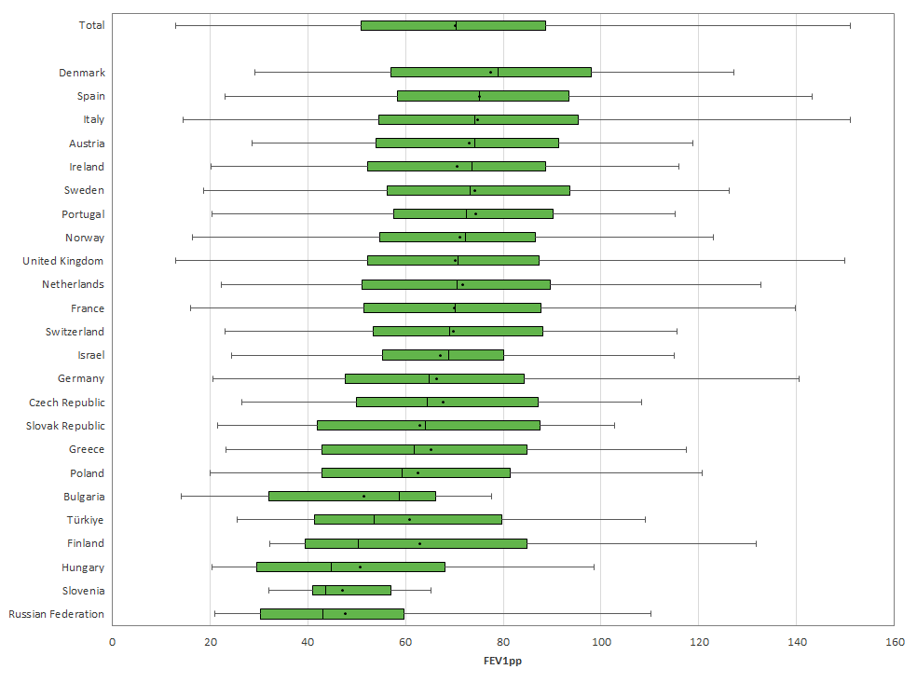
Figure 4.4
The median FEV1% of predicted for adults with CF who are more than 40 years old varies between 43% and 80% depending on the country.
FEV1pp: boxplot by country. Adults with CF who have never had a transplant, seen by a clinician in 2024.
Note: Albania, Armenia, Belarus, BA-Republika Srpska, Croatia, Cyprus, Estonia, Georgia, Kazakhstan, Kosovo, Iceland, Latvia, Lithuania, Luxembourg, Montenegro, North Macedonia, Republic of Moldova, Romania, Serbia, and Ukraine all have <5 individuals over 40 with a FEV1 value recorded in 2024 and all these countries were excluded from the graph.
Note: For Hungary, Italy, the Russian Federation and Slovenia no FEV1 value was reported for more than 10% of the over 40s with CF.
Note: Sweden reported the FEV1 of the best FEV1pp in the 12 months prior to the annual review which means that the value could be from 2023 or 2024. The UK reported the EFEV1 of the best FEV1pp from the period between annual reviews, which also means that the value could be from 2023 or 2024.
Zolin, A., Adamoli, A., Zomer, D., Fox, A., Krasnyk, M., Lorca Mayor, S., Prasad, V., Gambazza, S., Orenti, A., Gkolia, P., Cook, E., Duckers, J., Jung, A., Laidlaw, K., Dubois, C., Kirwan, L., Krivec, U., Naehrlich, L., & Bakkeheim, E. (2026). ECFSPR 2024 Annual Data Report. Zenodo. https://doi.org/10.5281/zenodo.20085096

Slide 28
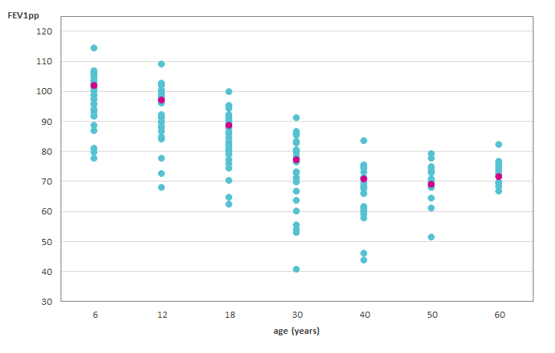
Figure 4.5
Lung function declines between the third and fifth decade of life but stabilises in older people with CF.
Median FEV1% of predicted by age group and by country.
Note: We excluded from the graph those age groups where the number of individuals was <10.
This graph shows the median (the value that separates the higher half from the lower half) FEV1% of predicted by age group. Each country median is represented by a dot (in turquoise), and the overall median is in pink. The general pattern shows that the FEV1% of predicted slowly decreases until the ages of 40-49 and then levels out. The people in the older age groups may have a less severe form of the disease and therefore live longer. There is considerable variation amongst the countries.
Zolin, A., Adamoli, A., Zomer, D., Fox, A., Krasnyk, M., Lorca Mayor, S., Prasad, V., Gambazza, S., Orenti, A., Gkolia, P., Cook, E., Duckers, J., Jung, A., Laidlaw, K., Dubois, C., Kirwan, L., Krivec, U., Naehrlich, L., & Bakkeheim, E. (2026). ECFSPR 2024 Annual Data Report. Zenodo. https://doi.org/10.5281/zenodo.20085096

Slide 29
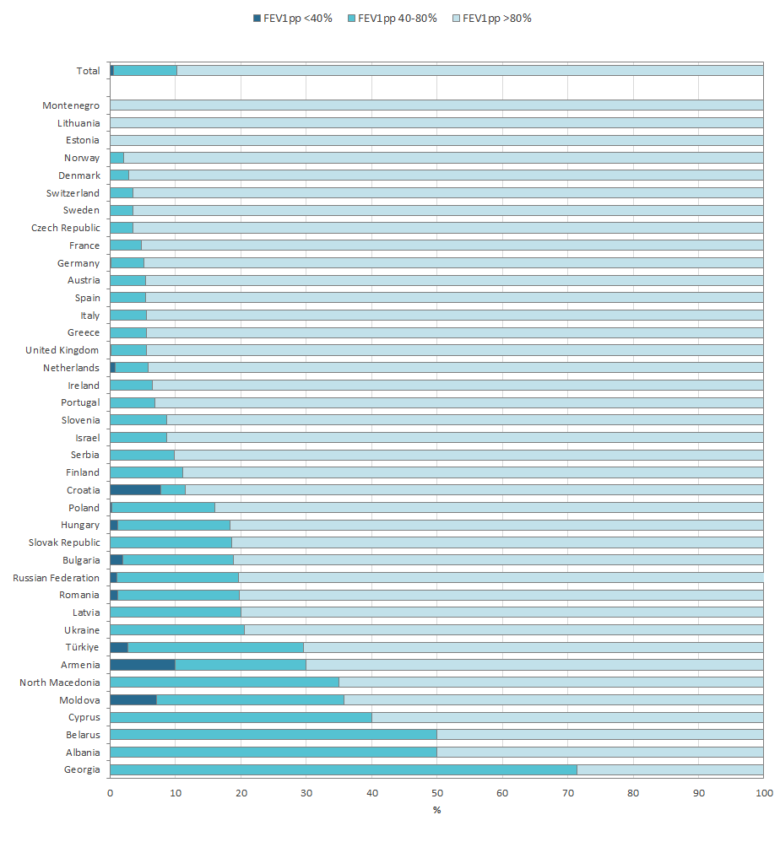
Figure 4.6
The majority of all children with CF in the ECFSPR have a FEV1% of predicted >80%.
FEV1pp severity group, by country and overall. Children with CF aged 6 – 11 years who have never had a transplant.
Note: BA-Republika Srpska, Iceland, Kazakhstan, Kosovo and Luxembourg have <5 individuals aged 6-11 years at the date of FEV1 and the countries are excluded from the graph.
Note: For Albania, Belarus, Cyprus, Georgia, Latvia, Moldova, North Macedonia, Romania, Serbia, the Russian Federation, Türkiye and Ukraine no FEV1 value was reported for more than 10% of the people with CF aged 6-11.
Note: Sweden reported the FEV1 of the best FEV1pp in the 12 months prior to the annual review; this means the value could be from 2023 or 2024. The UK reported the EFEV1 of the best FEV1pp from the period between annual reviews. This also means that the value could be from 2023 or 2024.
Zolin, A., Adamoli, A., Zomer, D., Fox, A., Krasnyk, M., Lorca Mayor, S., Prasad, V., Gambazza, S., Orenti, A., Gkolia, P., Cook, E., Duckers, J., Jung, A., Laidlaw, K., Dubois, C., Kirwan, L., Krivec, U., Naehrlich, L., & Bakkeheim, E. (2026). ECFSPR 2024 Annual Data Report. Zenodo. https://doi.org/10.5281/zenodo.20085096

Slide 30
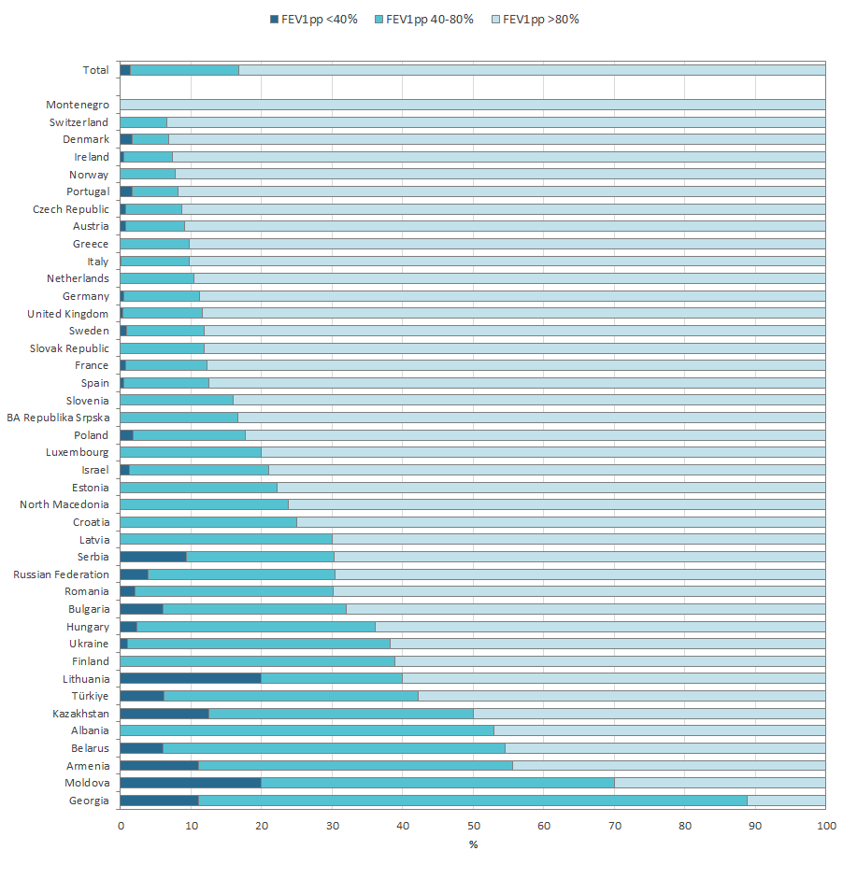
Figure 4.7
The majority of all adolescents with CF in Europe have a FEV1% of predicted greater than 80% predicted.
FEV1pp severity group, by country and overall. Adolescents with CF aged 12 – 17 years who have never had a transplant.
Note: Cyprus, Iceland and Kosovo have <5 individuals aged 12-17 years at the date of FEV1 and the countries are excluded from the graph.
Note: For Belarus, Georgia, Lithuania, the Russian Federation, Türkiye and Ukraine the information on FEV1% of predicted is missing for more than 10% of the people with CF aged 12-17.
Note: Sweden reported the FEV1 of the best FEV1pp in the 12 months prior to the annual review which means that the value could be from 2023 or 2024. The UK reported the EFEV1 of the best FEV1pp from the period between annual reviews, which also means that the value could be from 2023 or 2024.
Zolin, A., Adamoli, A., Zomer, D., Fox, A., Krasnyk, M., Lorca Mayor, S., Prasad, V., Gambazza, S., Orenti, A., Gkolia, P., Cook, E., Duckers, J., Jung, A., Laidlaw, K., Dubois, C., Kirwan, L., Krivec, U., Naehrlich, L., & Bakkeheim, E. (2026). ECFSPR 2024 Annual Data Report. Zenodo. https://doi.org/10.5281/zenodo.20085096

Slide 31
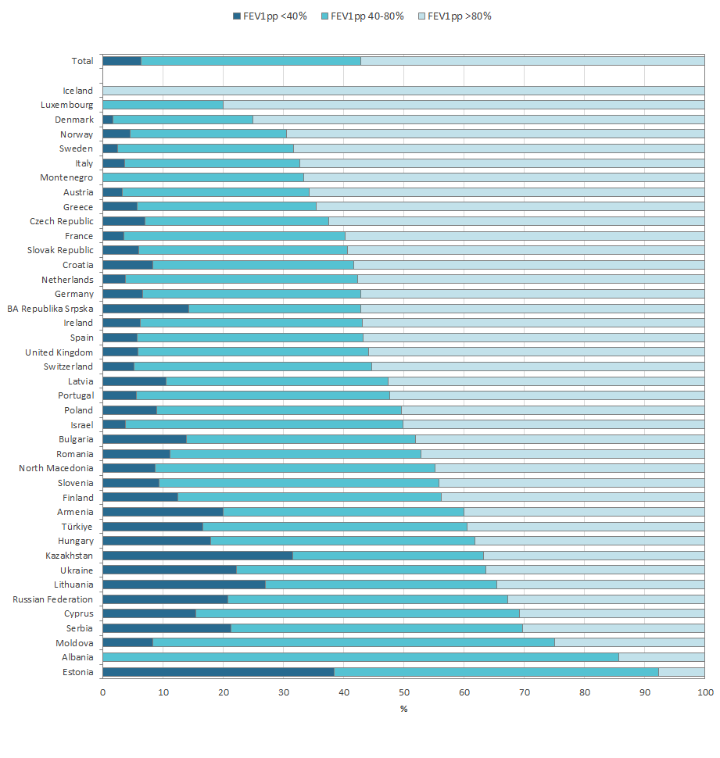
Figure 4.8
In the majority of countries, most adults with CF aged 18-39 years have a FEV1 of >80% predicted.
FEV1pp severity group, by country and overall. Adults with CF aged 18-39 years who have never had a transplant.
Note: Belarus, Georgia and Kosovo have <5 individuals aged 18-39 years at the date of FEV1 measurement and the countries are excluded from the graph.
Note: For Moldova, the Russian Federation and Ukraine no FEV1 value was reported for more than 10% of the people with CF aged between 18 and 39.
Note: Sweden reported the FEV1 of the best FEV1pp in the 12 months prior to the annual review which means that the value could be from 2023 or 2024. The UK reported the EFEV1 of the best FEV1pp from the period between annual reviews, which also means that the value could be from 2023 or 2024.
Zolin, A., Adamoli, A., Zomer, D., Fox, A., Krasnyk, M., Lorca Mayor, S., Prasad, V., Gambazza, S., Orenti, A., Gkolia, P., Cook, E., Duckers, J., Jung, A., Laidlaw, K., Dubois, C., Kirwan, L., Krivec, U., Naehrlich, L., & Bakkeheim, E. (2026). ECFSPR 2024 Annual Data Report. Zenodo. https://doi.org/10.5281/zenodo.20085096

Slide 32
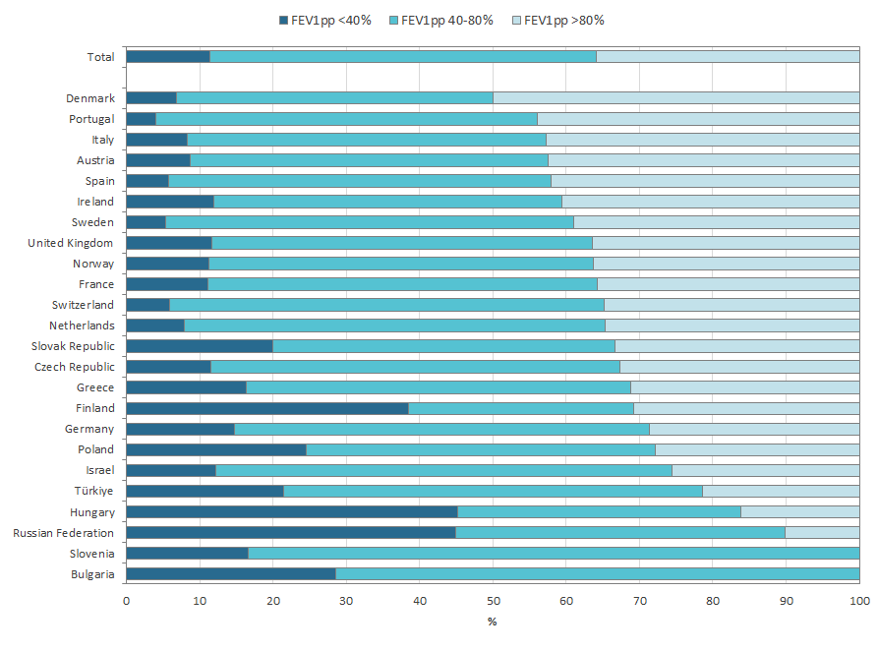
Figure 4.9
In the majority of countries in the ECFSPR, most adults with CF aged 40 years or older have a FEV1% of predicted between 40% and 80%.
FEV1pp severity group, by country and overall. Adults with CF aged 40 years or older who have never had a transplant.
Note: Albania, Armenia, Belarus, BA-Republika Srpska, Croatia, Cyprus, Estonia, Georgia, Kazakhstan, Kosovo, Iceland, Latvia, Lithuania, Luxembourg, Montenegro, North Macedonia, Republic of Moldova, Romania, Serbia, and Ukraine all have <5 individuals over 40 with a FEV1 value recorded in 2024 and all these countries were excluded from the graph.
Note: For Hungary, Italy, the Russian Federation and Slovenia no FEV1 value was reported for more than 10% of the over 40s with CF.
Note: Sweden reported the FEV1 of the best FEV1pp in the 12 months prior to the annual review which means that the value could be from 2023 or 2024. The UK reported the EFEV1 of the best FEV1pp from the period between annual reviews, which also means that the value could be from 2023 or 2024.
Zolin, A., Adamoli, A., Zomer, D., Fox, A., Krasnyk, M., Lorca Mayor, S., Prasad, V., Gambazza, S., Orenti, A., Gkolia, P., Cook, E., Duckers, J., Jung, A., Laidlaw, K., Dubois, C., Kirwan, L., Krivec, U., Naehrlich, L., & Bakkeheim, E. (2026). ECFSPR 2024 Annual Data Report. Zenodo. https://doi.org/10.5281/zenodo.20085096

Slide 33
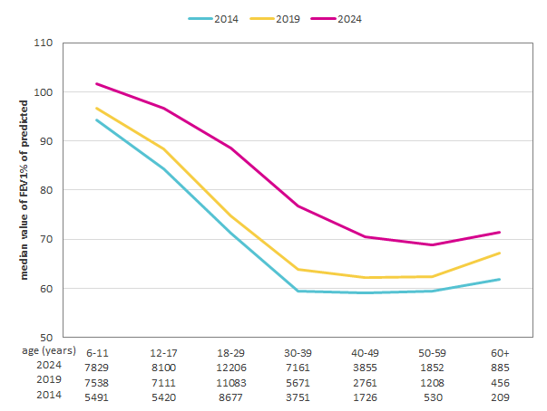
Figure 4.10
Pulmonary function, expressed as FEV1% of predicted, has been increasing over the years in all age groups, with a clear improvement since the introduction of CFTR modulators.
Median FEV1% of predicted by age group in 2014, 2019 and 2024.
Note: People with CF aged 6 years or older at the date of lung function measurement and who have never had a lung or liver transplant.
Zolin, A., Adamoli, A., Zomer, D., Fox, A., Krasnyk, M., Lorca Mayor, S., Prasad, V., Gambazza, S., Orenti, A., Gkolia, P., Cook, E., Duckers, J., Jung, A., Laidlaw, K., Dubois, C., Kirwan, L., Krivec, U., Naehrlich, L., & Bakkeheim, E. (2026). ECFSPR 2024 Annual Data Report. Zenodo. https://doi.org/10.5281/zenodo.20085096

Slide 34
CHAPTER 5 MICROBIOLOGY
https://pr.ecfs.eu/

Slide 35
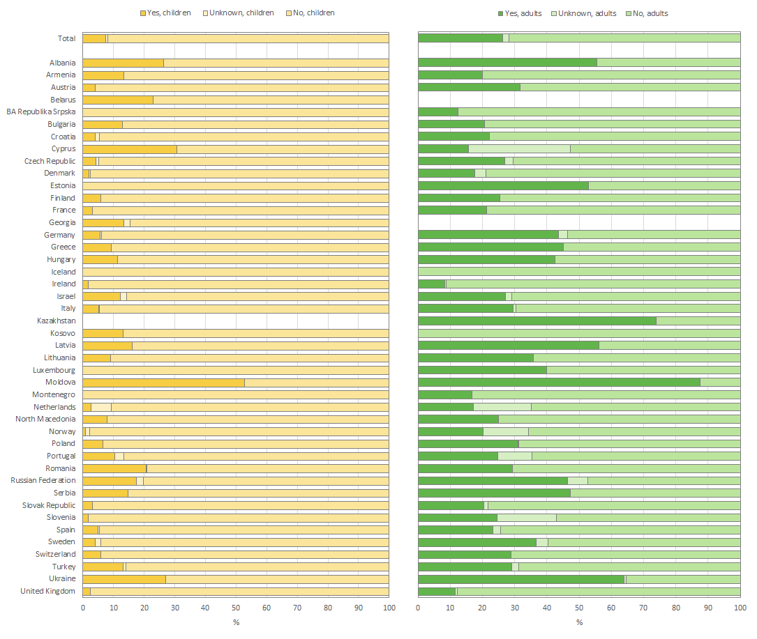
Figure 5.1
Pseudomonas aeruginosa, together with Staphylococcus aureus and Haemophilus influenzae, is the predominant respiratory pathogen in people with CF, though prevalence varies between age and countries.
Prevalence of Chronic Pseudomonas aeruginosa in people with CF seen by a clinician in 2024 who have never had a transplant, by country. The graph on the left presents the data for children and adolescents under 18 years of age and that on the right presents the data for adults.
Note: Information was missing for more than 10% of children in Kosovo, and for more than 10% of adults in Armenia, Iceland, Kosovo and Latvia. Belarus and Georgia has <5 adults seen in 2024 and are excluded from the graph for adults.
Note:
Ireland: Chronicity for Pseudomonas aeruginosa was defined as: a) 4 or more unique cultures in 2024 and greater than 50% positive b) at least 3 or more positive cultures during the 12 months preceding the last reported culture in 2024 or c) if chronic in 2023 and any cultures taken in 2024 were still positive.
Italy: chronicity for Pseudomonas aeruginosa was defines as “at least 3 or more positive isolates during the 12 months preceding the last reported culture in 2024”.
The United Kingdom: chronicity for Pseudomonas aeruginosa was defined as “3 or more positive isolates during the 12months preceding the last annual review”.
Zolin, A., Adamoli, A., Zomer, D., Fox, A., Krasnyk, M., Lorca Mayor, S., Prasad, V., Gambazza, S., Orenti, A., Gkolia, P., Cook, E., Duckers, J., Jung, A., Laidlaw, K., Dubois, C., Kirwan, L., Krivec, U., Naehrlich, L., & Bakkeheim, E. (2026). ECFSPR 2024 Annual Data Report. Zenodo. https://doi.org/10.5281/zenodo.20085096

Slide 36
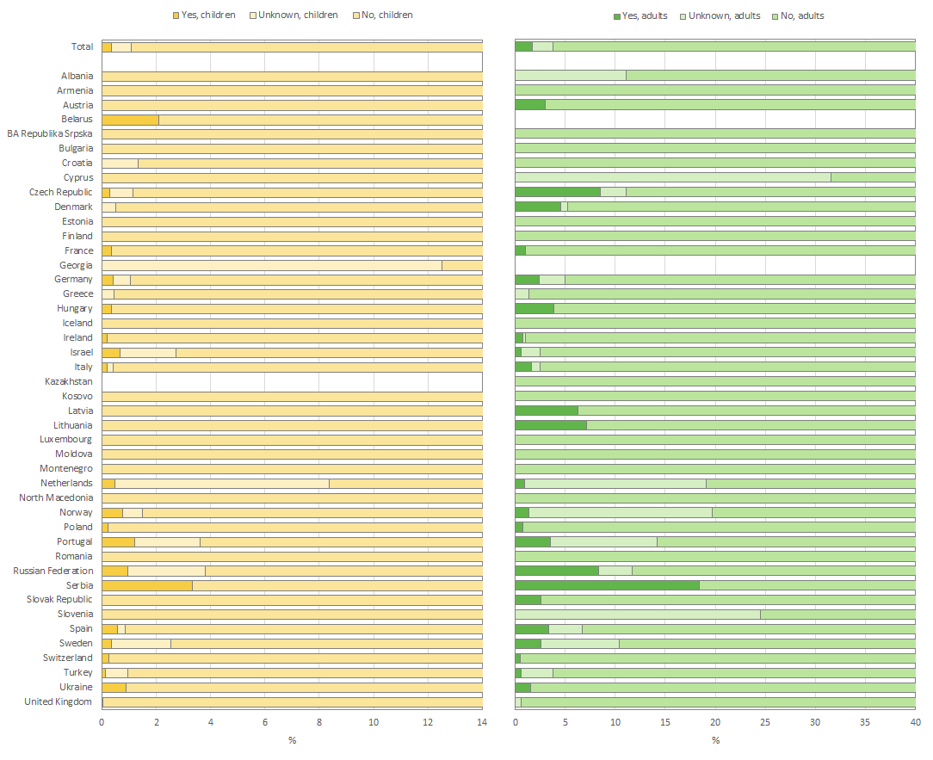
Figure 5.2
Burkholderia cepacia complex species belong to the emerging respiratory pathogens, with a prevalence of >5% in some countries.
Prevalence of chronic Burkholderia cepacia complex species in people with CF seen by a clinician in 2024 who have never had a transplant, by country. The graph on the left presents the data for children and adolescents under 18 years of age and that on the right presents the data for adults.
Note: Information was missing for more than 10% of children in Armenia and Kosovo, and for more than 10% of adults in Armenia, BA-Republika Srpska, Iceland, Kosovo, Latvia and Moldova. Belarus and Georgia have <5 adults seen in 2024 and are excluded form the graph for adults.
Note:
Ireland: Chronicity for Burkholderia cepacia complex was defined as: a) 4 or more unique cultures in 2024 and greater than 50% positive b) at least 3 or more positive cultures during the 12 months preceding the last reported culture in 2024 or c) if chronic in 2023 and any cultures taken in 2024 were still positive.
Italy: chronicity for Burkholderia cepacia complex was defined as “at least 3 or more positive isolates during the last 12 months preceding the last reported culture in 2024”.
The United Kingdom: chronicity for Burkholderia cepacia complex was not collected.
Zolin, A., Adamoli, A., Zomer, D., Fox, A., Krasnyk, M., Lorca Mayor, S., Prasad, V., Gambazza, S., Orenti, A., Gkolia, P., Cook, E., Duckers, J., Jung, A., Laidlaw, K., Dubois, C., Kirwan, L., Krivec, U., Naehrlich, L., & Bakkeheim, E. (2026). ECFSPR 2024 Annual Data Report. Zenodo. https://doi.org/10.5281/zenodo.20085096

Slide 37
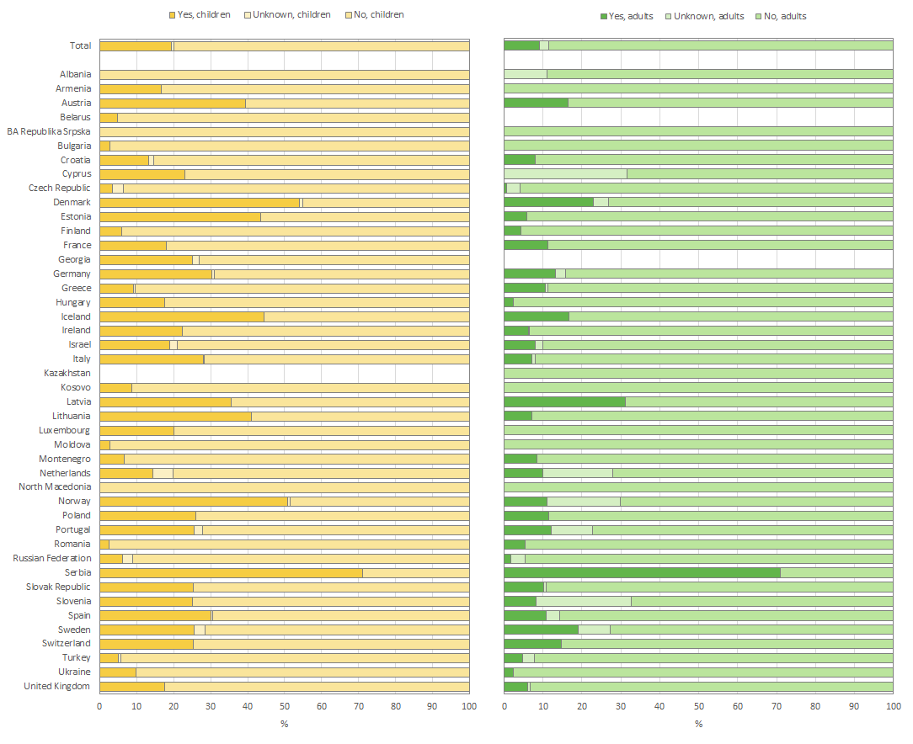
Figure 5.3
Haemophilus influenzae, together with Pseudomonas aeruginosa and Staphylococcus aureus, is one of the predominant respiratory pathogens in people with CF, though prevalence varies between age and countries.
Prevalence of Haemophilus influenzae (detected at least one) in people with CF seen by a clinician in 2024 who have never had a transplant, by country. The graph on the left presents the data for children and adolescents under the age of 18 and that on the right presents the data for adults.
Note: Information was missing for more than 10% of children in Kosovo, and for more than 10% of adults in Armenia, BA-Republika Srpska, Iceland, Kosovo and Latvia. Belarus and Georgia have <5 adults seen in 2024 and are excluded form the graph for adults.
Note:
France and United Kingdom: chronicity for Haemphilus influenzae was not collected.
Ireland: Chronicity for Haemophilus influenzae was defined as: a) 4 or more unique cultures in 2024 and greater than 50% positive b) at least 3 or more positive cultures during the 12 months preceding the last reported culture in 2024 or c) if chronic in 2023 and any cultures taken in 2024 were still positive.
Italy: chronicity for Haemophilus influenzae was defined as “at least 3 or more positive isolates during the 12 months preceding the last reported culture in 2024”.
Zolin, A., Adamoli, A., Zomer, D., Fox, A., Krasnyk, M., Lorca Mayor, S., Prasad, V., Gambazza, S., Orenti, A., Gkolia, P., Cook, E., Duckers, J., Jung, A., Laidlaw, K., Dubois, C., Kirwan, L., Krivec, U., Naehrlich, L., & Bakkeheim, E. (2026). ECFSPR 2024 Annual Data Report. Zenodo. https://doi.org/10.5281/zenodo.20085096

Slide 38
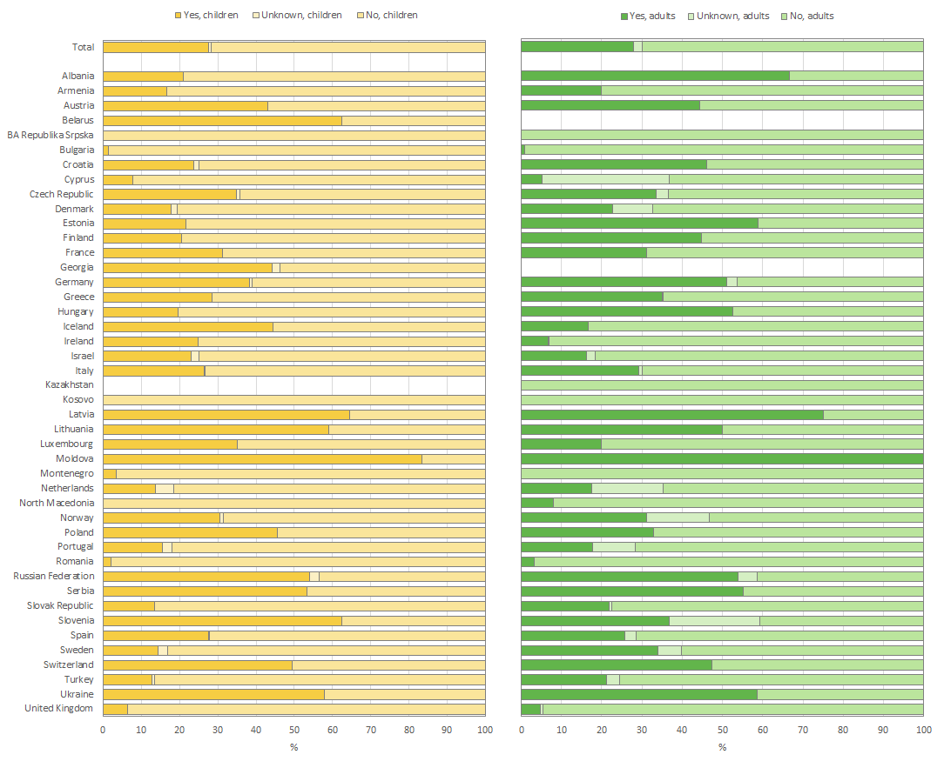
Figure 5.4
Staphylococcus aureus, together with Pseudomonas aeruginosa and Haemophilus influenzae, is a predominant respiratory pathogen in people with CF, though prevalence varies by age and between countries.
Prevalence of chronic methicillin-sensitive Staphylococcus aureus (MSSA) in people with CF seen by a clinician in 2024 who have never had a transplant, by country. The graph on the left presents the data for children and adolescents under the age of 18 and that on the right presents the data for adults.
Note: Information was missing for more than 10% of children in Kosovo, and for more than 10% of adults in Armenia, BA-Republika Srpska, Iceland, Kosovo and Latvia. Belarus and Georgia have <5 adults seen in 2024 and are excluded form the graph for adults.
Note:
Ireland: Chronicity for Staphylococcus aureus was defined as: a) 4 or more unique cultures in 2024 and greater than 50% positive b) at least 3 or more positive cultures during the 12 months preceding the last reported culture in 2024 or c) if chronic in 2023 and any cultures taken in 2024 were still positive.
Italy: chronicity for Staphylococcus aureus was defined as “at least 3 or more positive isolates during the last 12 months preceding the last reported culture in 2024”.
The United Kingdom: chronicity for Staphylococcus aureus was not collected.
Zolin, A., Adamoli, A., Zomer, D., Fox, A., Krasnyk, M., Lorca Mayor, S., Prasad, V., Gambazza, S., Orenti, A., Gkolia, P., Cook, E., Duckers, J., Jung, A., Laidlaw, K., Dubois, C., Kirwan, L., Krivec, U., Naehrlich, L., & Bakkeheim, E. (2026). ECFSPR 2024 Annual Data Report. Zenodo. https://doi.org/10.5281/zenodo.20085096

Slide 39
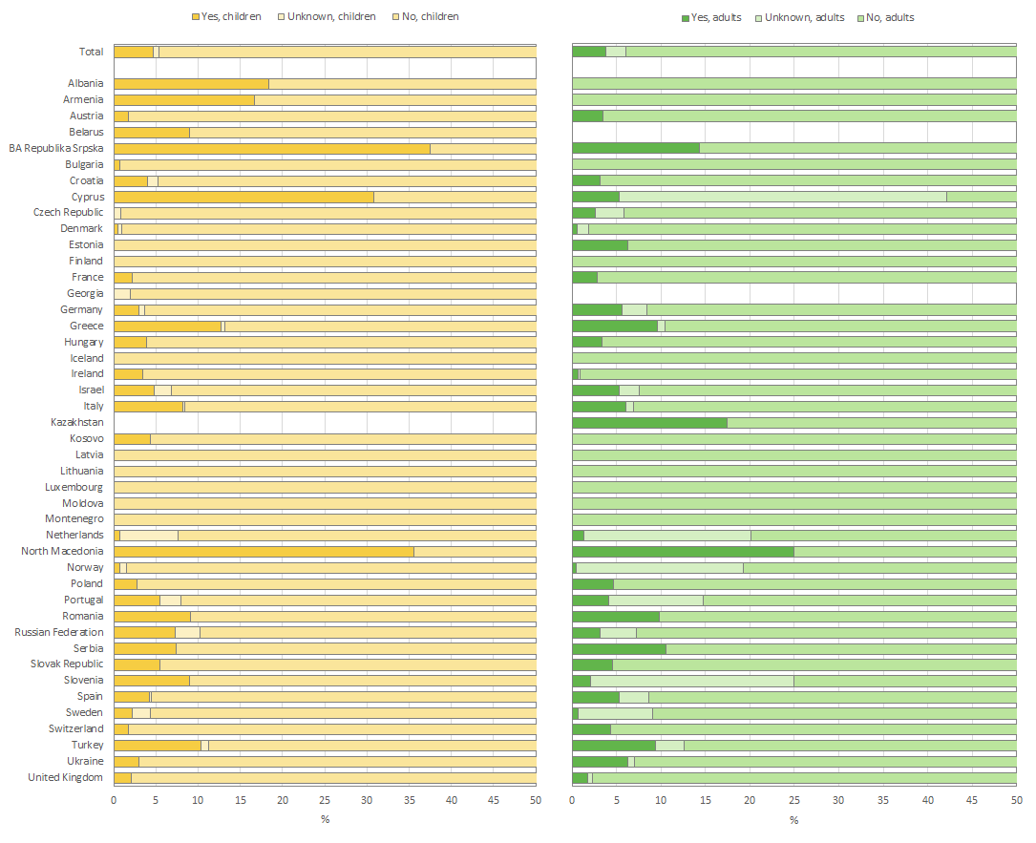
Figure 5.5
Prevalence of methicillin-resistant Staphylococcus aureus (MRSA) in the airways is very heterogeneous in people with CF throughout Europe.
Prevalence of methicillin-resistant Staphylococcus aureus (MRSA) (detected at least once a year) in people with CF seen by a clinician in 2024 who have never had a transplant, by country. The graph on the left presents the data for children and adolescents under the age of 18 and that on the right presents the data for adults.
Note: Information was missing for more than 10% of children in Armenia and Kosovo, and for more than 10% of adults in Armenia, BA-Republika Srpska, Iceland, Kosovo and Latvia. Belarus and Georgia have <5 adults seen in 2024 and are excluded form the graph for adults.
Note:
Ireland: Chronicity for methicillin-resistant Staphylococcus aureus was defined as: a) 4 or more unique cultures in 2024 and greater than 50% positive b) at least 3 or more positive cultures during the 12 months preceding the last reported culture in 2024 or c) if chronic in 2023 and any cultures taken in 2024 were still positive.
Italy: chronicity for methicillin-resistant Staphylococcus aureus was defined as “at least 3 or more positive isolates during the last 12 months preceding the last reported culture in 2024”.
The United Kingdom: chronicity for Staphylococcus aureus was not collected.
Zolin, A., Adamoli, A., Zomer, D., Fox, A., Krasnyk, M., Lorca Mayor, S., Prasad, V., Gambazza, S., Orenti, A., Gkolia, P., Cook, E., Duckers, J., Jung, A., Laidlaw, K., Dubois, C., Kirwan, L., Krivec, U., Naehrlich, L., & Bakkeheim, E. (2026). ECFSPR 2024 Annual Data Report. Zenodo. https://doi.org/10.5281/zenodo.20085096

Slide 40
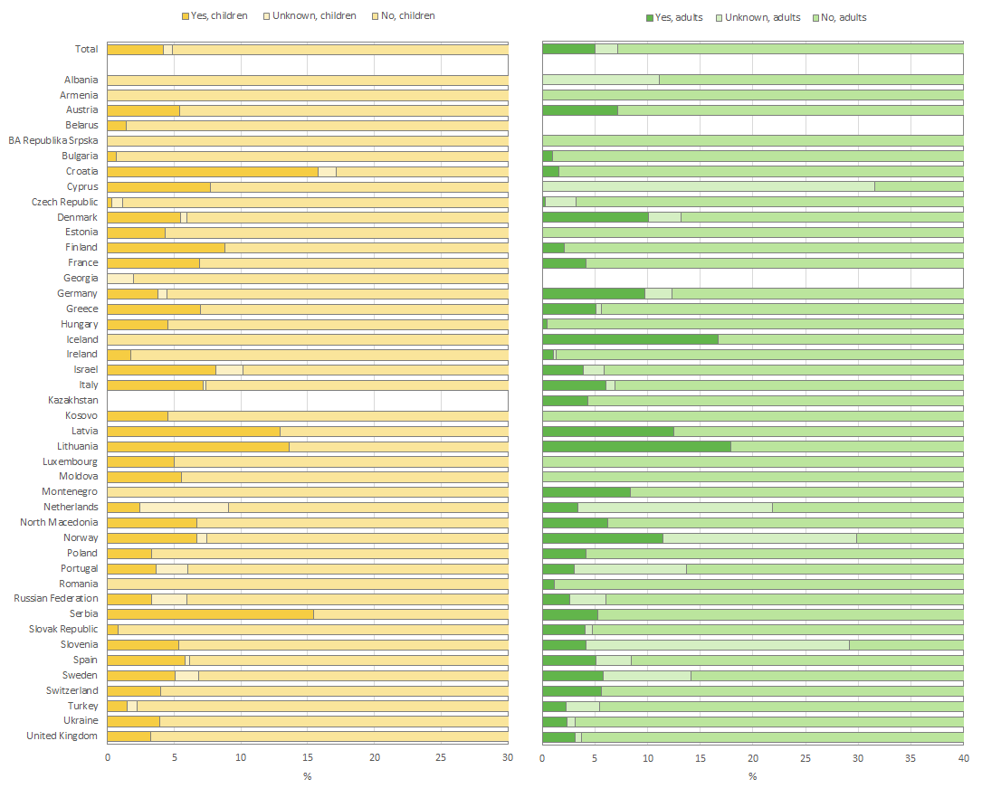
Figure 5.6
In the majority of countries, Stenotrophomonas maltophilia is found in less than 10% in children and adults with CF.
Prevalence of Stenotrophomonas maltophilia (detected at least once a year) in people with CF seen by a clinician in 2024 who have never had a transplant, by country. The graph on the left presents the data for children and adolescents under the age of 18 and that on the right presents the data for adults.
Note: Information was missing for more than 10% of children in Armenia and Kosovo, and for more than 10% of adults in Armenia, BA-Republika Srpska, Iceland, Kosovo and Latvia. Belarus and Georgia have <5 adults seen in 2024 and are excluded form the graph for adults.
Note:
Ireland: Chronicity for Stenotrophomonas maltophilia was defined as: a) 4 or more unique cultures in 2024 and greater than 50% positive b) at least 3 or more positive cultures during the 12 months preceding the last reported culture in 2024 or c) if chronic in 2023 and any cultures taken in 2024 were still positive.
Italy: chronicity for Stenotrophomonas maltophilia was defined as “at least 3 or more positive isolates during the last 12 months preceding the last reported culture in 2024”.
The United Kingdom: chronicity for Stenotrophomonas maltophilia was not collected.
Zolin, A., Adamoli, A., Zomer, D., Fox, A., Krasnyk, M., Lorca Mayor, S., Prasad, V., Gambazza, S., Orenti, A., Gkolia, P., Cook, E., Duckers, J., Jung, A., Laidlaw, K., Dubois, C., Kirwan, L., Krivec, U., Naehrlich, L., & Bakkeheim, E. (2026). ECFSPR 2024 Annual Data Report. Zenodo. https://doi.org/10.5281/zenodo.20085096

Slide 41
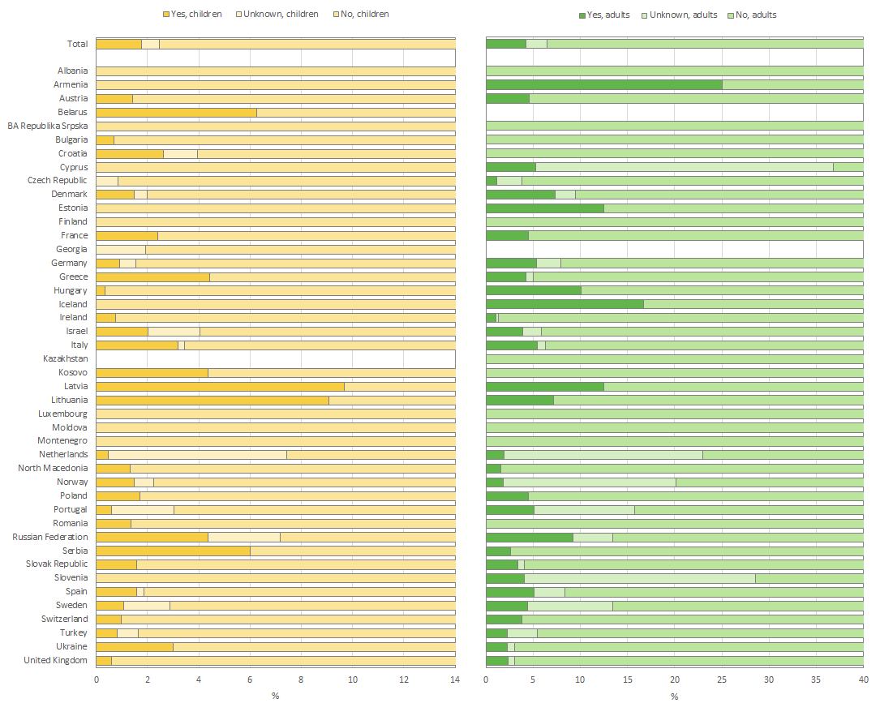
Figure 5.7
Achromobacter species can be found in up to 20% of the airways of people with CF, with a higher prevalence in adults.
Prevalence of Achromobacter species infection (detected at least once a year) in people with CF seen by a clinician in 2024 who have never had a transplant, by country. The graph on the left presents the data for children and adolescents under the age of 18 and that on the right presents the data for adults. Note the different scale on the horizontal axis.
Note: Information was missing for more than 10% of children in Armenia and Kosovo, and for more than 10% of adults in Armenia, BA-Republika Srpska, Iceland, Kosovo and Latvia. Belarus and Georgia have <5 adults seen in 2024 and are excluded form the graph for adults.
Note:
Ireland: Chronicity for Achromobacter species was defined as: a) 4 or more unique cultures in 2024 and greater than 50% positive b) at least 3 or more positive cultures during the 12 months preceding the last reported culture in 2024 or c) if chronic in 2023 and any cultures taken in 2024 were still positive.
Italy: chronicity for Achromobacter species was defined as “at least 3 or more positive isolates during the last 12 months preceding the last reported culture in 2024”.
The United Kingdom: chronicity for Achromobacter species was not collected.
Zolin, A., Adamoli, A., Zomer, D., Fox, A., Krasnyk, M., Lorca Mayor, S., Prasad, V., Gambazza, S., Orenti, A., Gkolia, P., Cook, E., Duckers, J., Jung, A., Laidlaw, K., Dubois, C., Kirwan, L., Krivec, U., Naehrlich, L., & Bakkeheim, E. (2026). ECFSPR 2024 Annual Data Report. Zenodo. https://doi.org/10.5281/zenodo.20085096

Slide 42
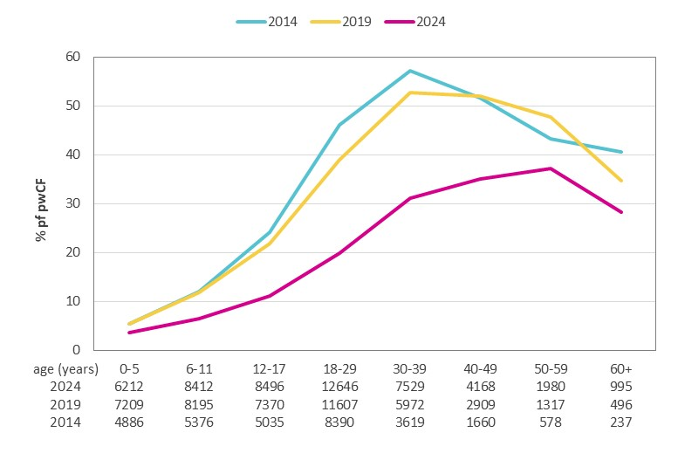
Figure 5.8
The prevalence of chronic Pseudomonas aeruginosa infection has decreased in the CF population in Europe since increased availability of CFTR modulators.
Prevalence of chronic Pseudomonas aeruginosa infection in people with CF, by age group, in 2014, 2019 and 2024.
In this graph we present data over time using cross sectional data per year of people with a confirmed CF diagnosis. All people with CF alive, deceased, or not seen during the year of follow-up were included. Individuals who have had a lung or/and liver transplant at some point during their life were excluded.
Zolin, A., Adamoli, A., Zomer, D., Fox, A., Krasnyk, M., Lorca Mayor, S., Prasad, V., Gambazza, S., Orenti, A., Gkolia, P., Cook, E., Duckers, J., Jung, A., Laidlaw, K., Dubois, C., Kirwan, L., Krivec, U., Naehrlich, L., & Bakkeheim, E. (2026). ECFSPR 2024 Annual Data Report. Zenodo. https://doi.org/10.5281/zenodo.20085096

Slide 43
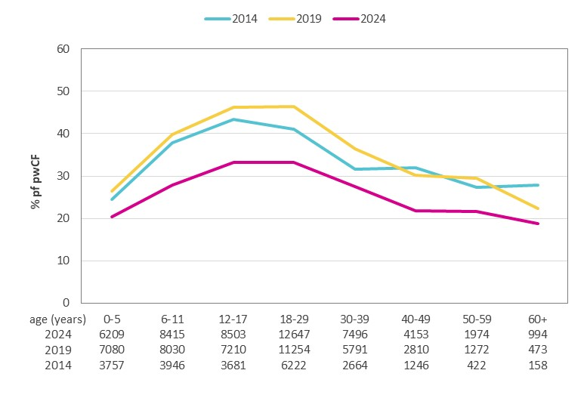
Figure 5.9
The prevalence of chronic Methicillin-sensitive Staphylococcus aureus infection has decreased in the CF population in Europe since increased availability of CFTR modulators.
Prevalence of chronic Methicillin-sensitive Staphylococcus aureus infection in people with CF, by age group, in 2014, 2019 and 2024.
In this graph we present data over time using cross sectional data per year of people with a confirmed CF diagnosis. All people with CF alive, deceased, or not seen during the year of follow-up were included. Individuals who have had a lung or/and liver transplant at some point during their life were excluded.
Zolin, A., Adamoli, A., Zomer, D., Fox, A., Krasnyk, M., Lorca Mayor, S., Prasad, V., Gambazza, S., Orenti, A., Gkolia, P., Cook, E., Duckers, J., Jung, A., Laidlaw, K., Dubois, C., Kirwan, L., Krivec, U., Naehrlich, L., & Bakkeheim, E. (2026). ECFSPR 2024 Annual Data Report. Zenodo. https://doi.org/10.5281/zenodo.20085096

Slide 44
CHAPTER 6 NUTRITION
https://pr.ecfs.eu/

Slide 45
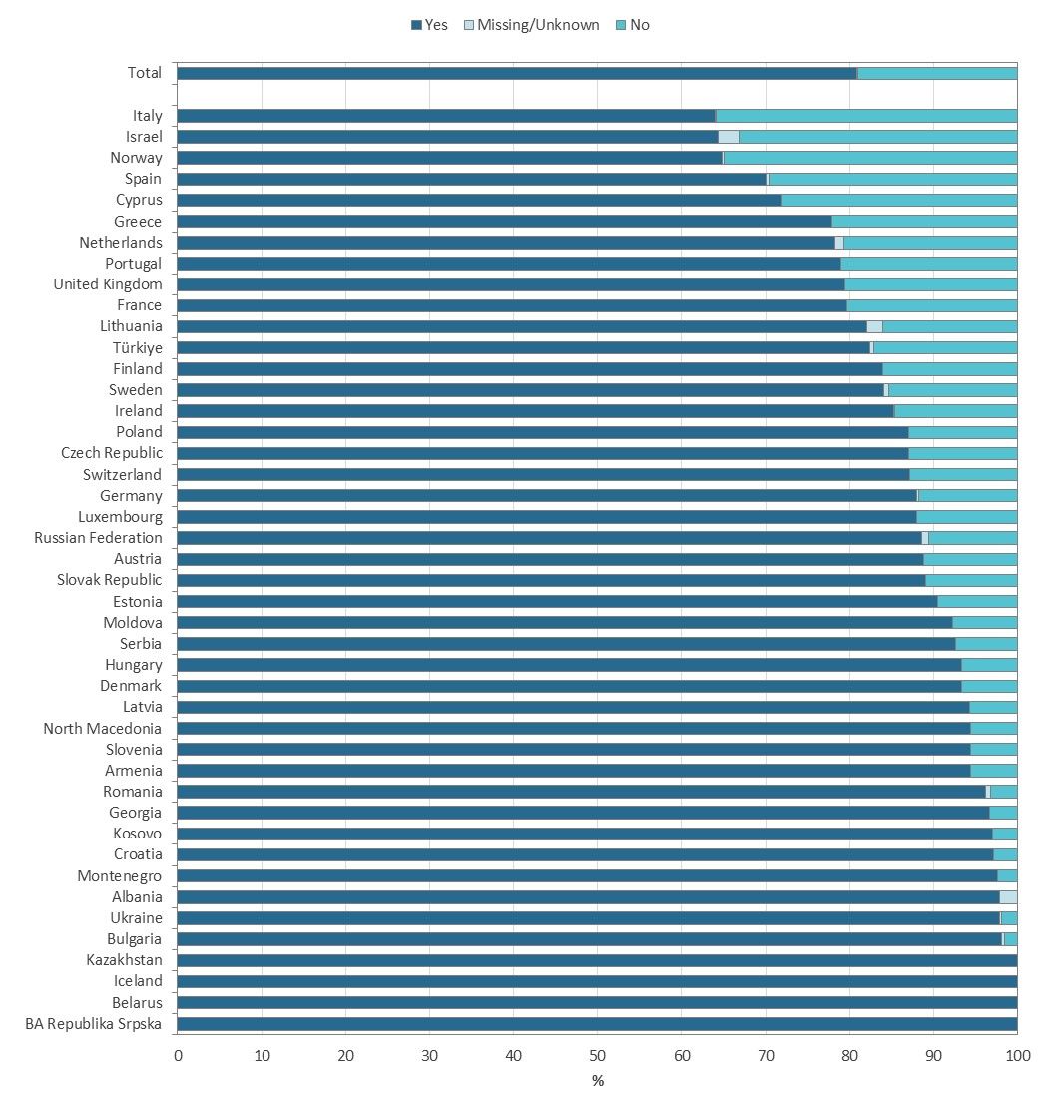
Figure 6.1
In the majority of countries in the ECFSPR, more than 80% of the people with CF are pancreatic insufficient.
Use of pancreatic enzymes in 2024 for all people with CF who have never had a transplant, by country.
Zolin, A., Adamoli, A., Zomer, D., Fox, A., Krasnyk, M., Lorca Mayor, S., Prasad, V., Gambazza, S., Orenti, A., Gkolia, P., Cook, E., Duckers, J., Jung, A., Laidlaw, K., Dubois, C., Kirwan, L., Krivec, U., Naehrlich, L., & Bakkeheim, E. (2026). ECFSPR 2024 Annual Data Report. Zenodo. https://doi.org/10.5281/zenodo.20085096

Slide 46
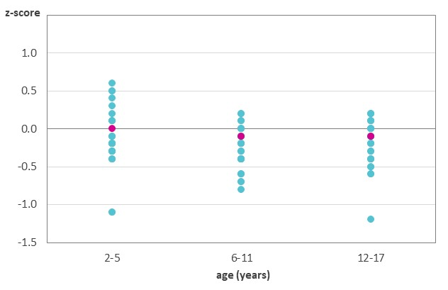
Figure 6.2
While the median BMI z-score for children and adolescents with CF in Europe is close to normal for all age groups, a lot of variation amongst the countries can be observed.
Median z-score for BMI by age group and by country. Children and adolescents with CF aged 2-17 years in 2024 who have never had a transplant.
Note: We excluded from the graph those age groups where the number of individuals was <10.
This graph shows the median z-score for BMI (the value that separates the higher and lower half of the people with CF) by age group. Each country median is represented by a turquoise dot and the median overall for the age group by a pink dot. There was a lot of variation between countries.
Zolin, A., Adamoli, A., Zomer, D., Fox, A., Krasnyk, M., Lorca Mayor, S., Prasad, V., Gambazza, S., Orenti, A., Gkolia, P., Cook, E., Duckers, J., Jung, A., Laidlaw, K., Dubois, C., Kirwan, L., Krivec, U., Naehrlich, L., & Bakkeheim, E. (2026). ECFSPR 2024 Annual Data Report. Zenodo. https://doi.org/10.5281/zenodo.20085096

Slide 47
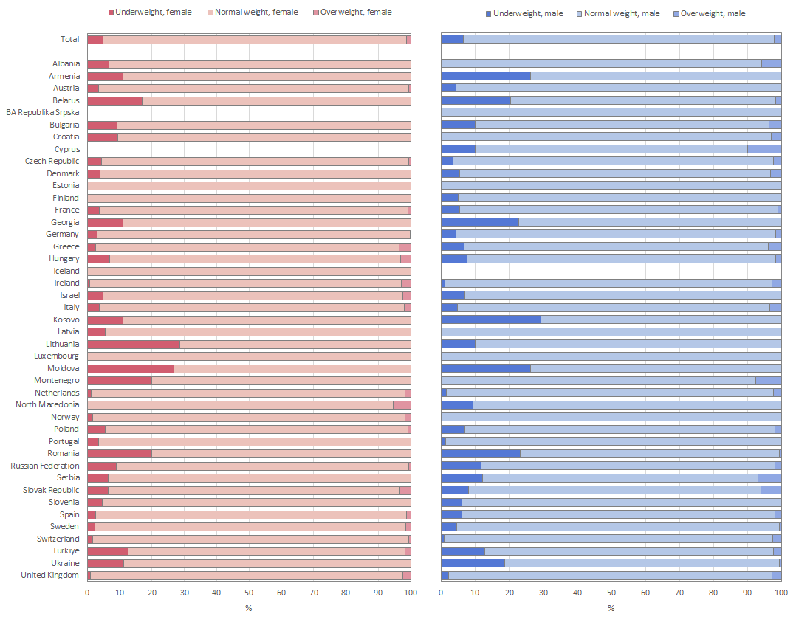
Figure 6.3
Being underweight is a clinical feature in children and adolescents with CF. There are considerable differences amongst the countries.
Proportion of children and adolescents with CF who are underweight (z-score of BMI <-2), normal (-2 ≤ z-score of BMI ≤ +2) and overweight (z-score of BMI >+2) by sex and by country, aged 2-17 years in 2024 and who have never had a transplant. The graph on the left presents the data for females and that on the right presents the data for males.
Note: BA-Republika Srpska and Cyprus have been excluded from the graph for females because the number of children and adolescents was <5. Iceland has been excluded from the graph for males because the number of children and adolescents was less than 5.
Zolin, A., Adamoli, A., Zomer, D., Fox, A., Krasnyk, M., Lorca Mayor, S., Prasad, V., Gambazza, S., Orenti, A., Gkolia, P., Cook, E., Duckers, J., Jung, A., Laidlaw, K., Dubois, C., Kirwan, L., Krivec, U., Naehrlich, L., & Bakkeheim, E. (2026). ECFSPR 2024 Annual Data Report. Zenodo. https://doi.org/10.5281/zenodo.20085096

Slide 48
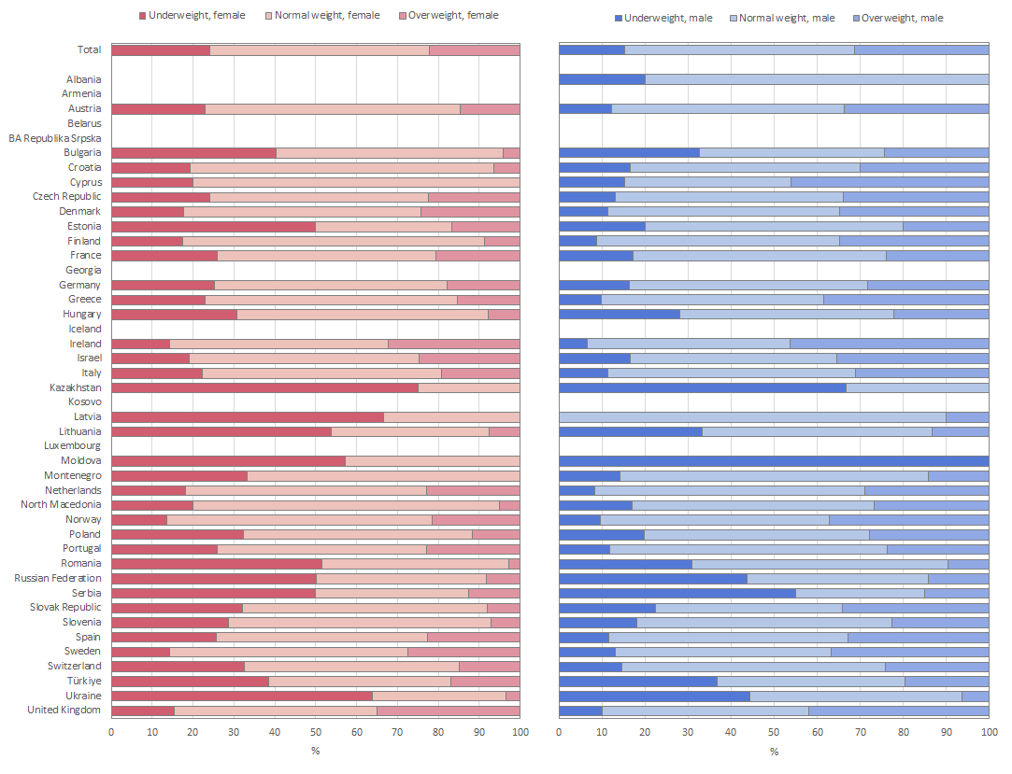
Figure 6.4
Having suboptimal weight is a clinical feature in adults with CF and more common in females. There are considerable differences amongst the countries.
Proportion of adults with suboptimal weight (BMI <20), normal (20 ≤ BMI ≤ 25) and overweight (BMI >25) by sex and by country, aged 18 years or older in 2024 who never had a transplant. The graph on the left presents the data for females and that on the right presents the data for males.
Note: Information was missing for more than 10% of adults in Georgia and Ireland.
Note: Belarus and Georgia have <5 adults seen in 2024 and are excluded from both the graphs for adults.
Note: Albania, Armenia, BA-Republika Srpska, Iceland, Kosovo, Luxemburg and Montenegro have been excluded from the graph for females because the number of female adults was <5.
Note: Armenia, BA-Republika Srpska, Iceland, Kosovo and Luxemburg have been excluded from the graph for males because the number of male adults was <5.
Zolin, A., Adamoli, A., Zomer, D., Fox, A., Krasnyk, M., Lorca Mayor, S., Prasad, V., Gambazza, S., Orenti, A., Gkolia, P., Cook, E., Duckers, J., Jung, A., Laidlaw, K., Dubois, C., Kirwan, L., Krivec, U., Naehrlich, L., & Bakkeheim, E. (2026). ECFSPR 2024 Annual Data Report. Zenodo. https://doi.org/10.5281/zenodo.20085096

Slide 49
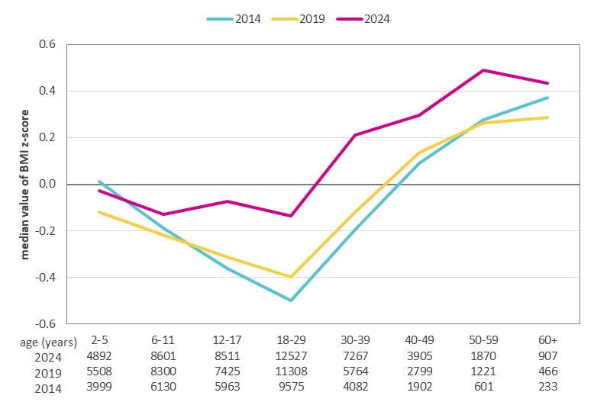
Figure 6.5
A significant improvement in BMI in 2024 from the age of 6 years reflects the efficacy of CFTR modulator therapy in Europe.
Median z-score for BMI by age group in 2014, 2019 and 2024.
Note: Only people with CF aged 2 years or more at measurement and who have never had a lung or liver transplant.
In this graph we present data over time using cross sectional data per year of people with a confirmed CF. All people with CF alive, deceased, or not seen during the year of follow-up were included. Individuals who have had a transplant in their lifetime (lung and/or liver) were excluded.
Zolin, A., Adamoli, A., Zomer, D., Fox, A., Krasnyk, M., Lorca Mayor, S., Prasad, V., Gambazza, S., Orenti, A., Gkolia, P., Cook, E., Duckers, J., Jung, A., Laidlaw, K., Dubois, C., Kirwan, L., Krivec, U., Naehrlich, L., & Bakkeheim, E. (2026). ECFSPR 2024 Annual Data Report. Zenodo. https://doi.org/10.5281/zenodo.20085096

Slide 50
CHAPTER 7 COMPLICATIONS
https://pr.ecfs.eu/

Slide 51
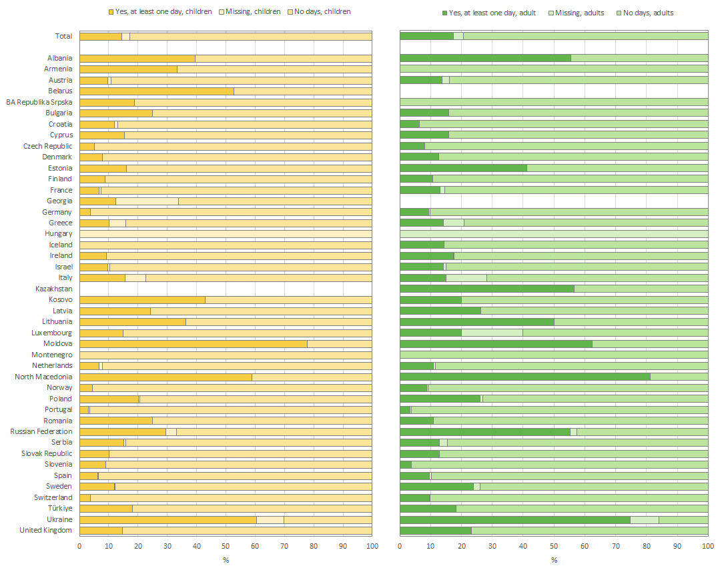
Figure 7.1
Prevalence in people with CF of at least 1 day on intravenous antibiotics varies between countries.
Prevalence in people with CF of at least 1 day on intravenous (IV) antibiotics (for CF-related reasons) at home and/or in hospital. People with CF seen in 2024, who have never had a transplant, by country and overall. The graph on the left presents the data for children and that on the right presents the data for adults.
Note: Belarus and Georgia have <5 adults seen in 2024 and are excluded from the table for adults, but the people are included in the total number.
Zolin, A., Adamoli, A., Zomer, D., Fox, A., Krasnyk, M., Lorca Mayor, S., Prasad, V., Gambazza, S., Orenti, A., Gkolia, P., Cook, E., Duckers, J., Jung, A., Laidlaw, K., Dubois, C., Kirwan, L., Krivec, U., Naehrlich, L., & Bakkeheim, E. (2026). ECFSPR 2024 Annual Data Report. Zenodo. https://doi.org/10.5281/zenodo.20085096

Slide 52
Figure 7.2
Prevalence in people with CF of at least 1 day on intravenous antibiotics varies between countries.
Prevalence in people with CF of at least 1 day in hospital, for any reason (routine check-up days not included). People with CF seen in 2024, who have never had a transplant, by country and overall. The graph on the left presents the data for children and that on the right presents the data for adults.
Note: Belarus and Georgia have <5 adults seen in 2024 and are excluded from the table for adults, but the people are included in the total number.
Zolin, A., Adamoli, A., Zomer, D., Fox, A., Krasnyk, M., Lorca Mayor, S., Prasad, V., Gambazza, S., Orenti, A., Gkolia, P., Cook, E., Duckers, J., Jung, A., Laidlaw, K., Dubois, C., Kirwan, L., Krivec, U., Naehrlich, L., & Bakkeheim, E. (2026). ECFSPR 2024 Annual Data Report. Zenodo. https://doi.org/10.5281/zenodo.20085096

Slide 53
CHAPTER 8 THERAPIES
https://pr.ecfs.eu/

Slide 54
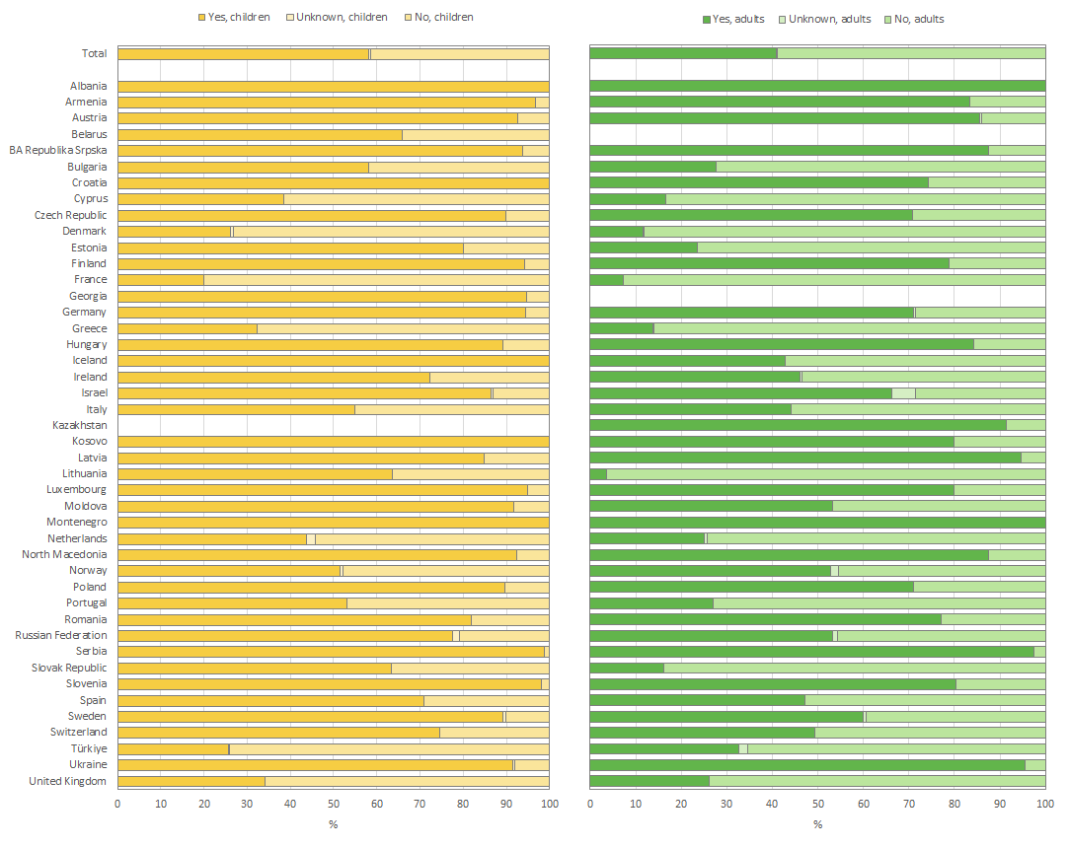
Figure 8.1
Variation in the use of inhaled hypertonic saline indicates both inequalities in availability and different therapeutic approaches.
Use of inhaled hypertonic saline in children and adolescents (<18 years of age) and adults seen by a clinician in 2024 who have never had a transplant, by country. The graph on the left presents the data for children and that on the right presents the data for adults.
Note: Belarus and Georgia have <5 adults seen in 2024 and are excluded from the graph for adults.
Note: Inhaled hypertonic saline was reimbursed in most countries except in Albania, Armenia, Bulgaria, Estonia, Georgia, Kazakhstan, Lithuania, the Republic of Moldova and Poland. In Kosovo in 2024 there was no system for the reimbursement of medication but inhaled hypertonic saline was offered free of charge for PwCF in hospital. In Türkiye it is reimbursed for children ≥ 6 years.
Zolin, A., Adamoli, A., Zomer, D., Fox, A., Krasnyk, M., Lorca Mayor, S., Prasad, V., Gambazza, S., Orenti, A., Gkolia, P., Cook, E., Duckers, J., Jung, A., Laidlaw, K., Dubois, C., Kirwan, L., Krivec, U., Naehrlich, L., & Bakkeheim, E. (2026). ECFSPR 2024 Annual Data Report. Zenodo. https://doi.org/10.5281/zenodo.20085096

Slide 55
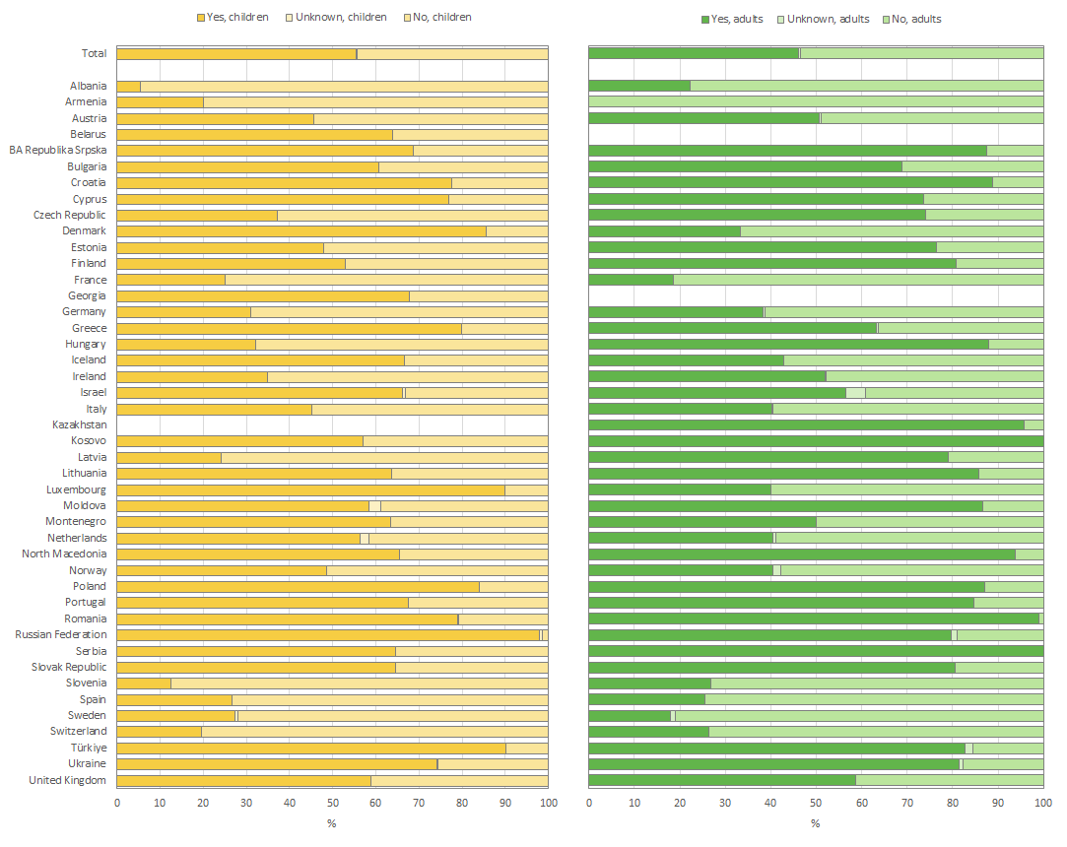
Figure 8.2
Variation in the use of rhDNAse indicates both inequalities in availability and different therapeutic approaches.
Use of rhDNAse in children and adolescents (<18 years of age) and adults seen by a clinician in 2024 who have never had a transplant, by country. The graph on the left presents the data for children and that on the right presents the data for adults.
Note: Information was missing for more than 10% of adults in Armenia. Belarus and Georgia have <5 adults seen in 2024 and are excluded from the graph for adults.
Note: Inhaled rhDNAse was reimbursed in most countries except in Albania, Armenia and Belarus. It was reimbursed in Georgia for people with CF ≥2 years, in Bulgaria, Estonia, France, Germany, Greece, Serbia, Luxembourg, Macedonia, the Republic of Moldova, Norway, Romania, Serbia, Spain, and the United Kingdom for individuals ≥5 years and in Latvia and Hungary for individuals ≥ 6 years. In Kosovo in 2024 there was no system for the reimbursement of medication but inhaled rhDNAse was offered free of charge for PwCF in hospital.
Zolin, A., Adamoli, A., Zomer, D., Fox, A., Krasnyk, M., Lorca Mayor, S., Prasad, V., Gambazza, S., Orenti, A., Gkolia, P., Cook, E., Duckers, J., Jung, A., Laidlaw, K., Dubois, C., Kirwan, L., Krivec, U., Naehrlich, L., & Bakkeheim, E. (2026). ECFSPR 2024 Annual Data Report. Zenodo. https://doi.org/10.5281/zenodo.20085096

Slide 56
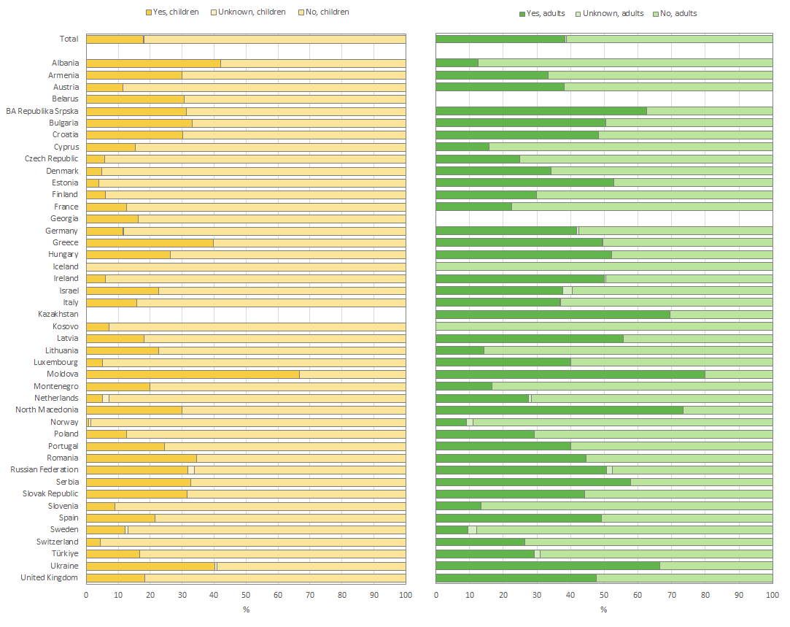
Figure 8.3
Inhaled antibiotics are still an important therapeutic strategy in the prevention of pulmonary exacerbations, specially in adults with CF.
Use of inhaled antibiotics in children and adolescents (<18 years of age) and adults seen by a clinician in 2024 who have never had a transplant, by country. The graph on the left presents the data for children and that on the right presents the data for adults.
Note: Information was missing for more than 10% of adults in Armenia. Belarus and Georgia have <5 adults seen in 2024 and are excluded from the graph for adults. Inhaled antibiotics were reimbursed in all countries except Armenia and Georgia. In Bulgaria, colistin was reimbursed for all PwCF, tobramycin for those > 7 years old, and levofloxacin for those > 18 years old. In Estonia, tobramycin and colistin were reimbursed. In Romania, only tobramycin solution and colistin dry powder were reimbursed and only for PwCF aged 6 and older. In Kosovo in 2024 there was no system for the reimbursement of medication but when the intravenous formulation of colistin is adapted as an inhaled formulation, it is offered free of charge for PwCF in hospital.
Zolin, A., Adamoli, A., Zomer, D., Fox, A., Krasnyk, M., Lorca Mayor, S., Prasad, V., Gambazza, S., Orenti, A., Gkolia, P., Cook, E., Duckers, J., Jung, A., Laidlaw, K., Dubois, C., Kirwan, L., Krivec, U., Naehrlich, L., & Bakkeheim, E. (2026). ECFSPR 2024 Annual Data Report. Zenodo. https://doi.org/10.5281/zenodo.20085096

Slide 57
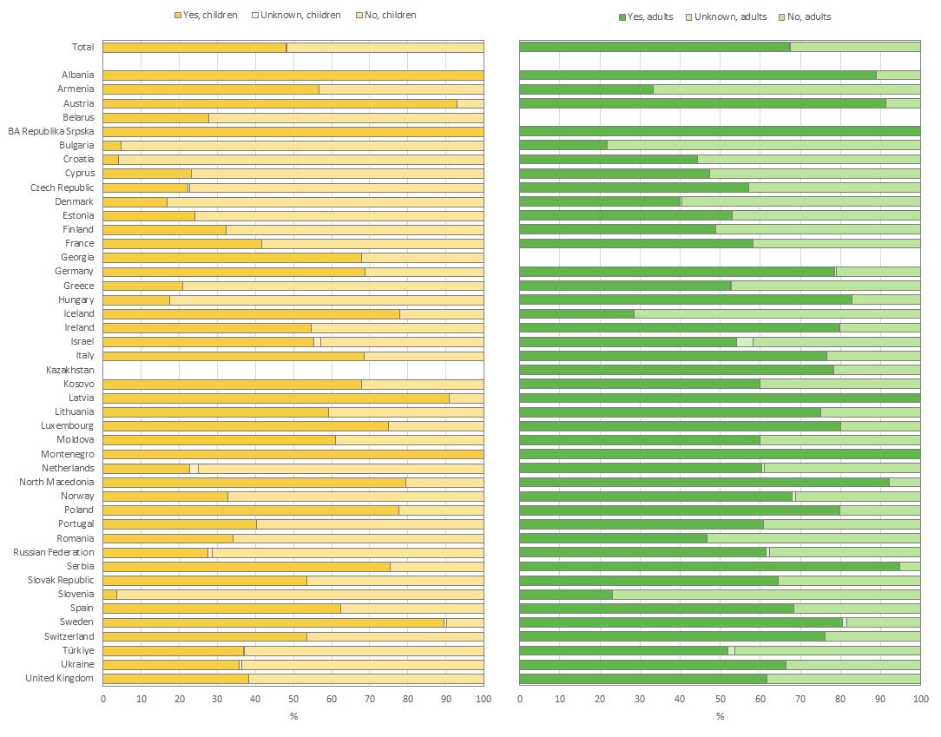
Figure 8.4
Bronchodilators (both short and long acting) are used as widespread supporting treatment in many countries in Europe.
Use of bronchodilators (short- or long-acting) in children and adolescents (<18 years of age) and adults seen by a clinician in 2024 who have never had a transplant, by country. The graph on the left presents the data for children and that on the right presents the data for adults.
Note: Belarus and Georgia have <5 adults seen in 2024 and are excluded from the graph for adults. Inhaled bronchodilators were reimbursed in most countries except in Bulgaria, Georgia, the Republic of Moldova (reimbursed for PwCF also diagnosed with asthma), Poland and Serbia. In Kazakhstan its availability depends on the regional budget. In Estonia long- and short-acting bronchodilators were reimbursed for PwCF also diagnosed with asthma. In Kosovo in 2024 there was no system for the reimbursement of medication and PwCF must cover the cost of the therapy themselves.
Zolin, A., Adamoli, A., Zomer, D., Fox, A., Krasnyk, M., Lorca Mayor, S., Prasad, V., Gambazza, S., Orenti, A., Gkolia, P., Cook, E., Duckers, J., Jung, A., Laidlaw, K., Dubois, C., Kirwan, L., Krivec, U., Naehrlich, L., & Bakkeheim, E. (2026). ECFSPR 2024 Annual Data Report. Zenodo. https://doi.org/10.5281/zenodo.20085096

Slide 58
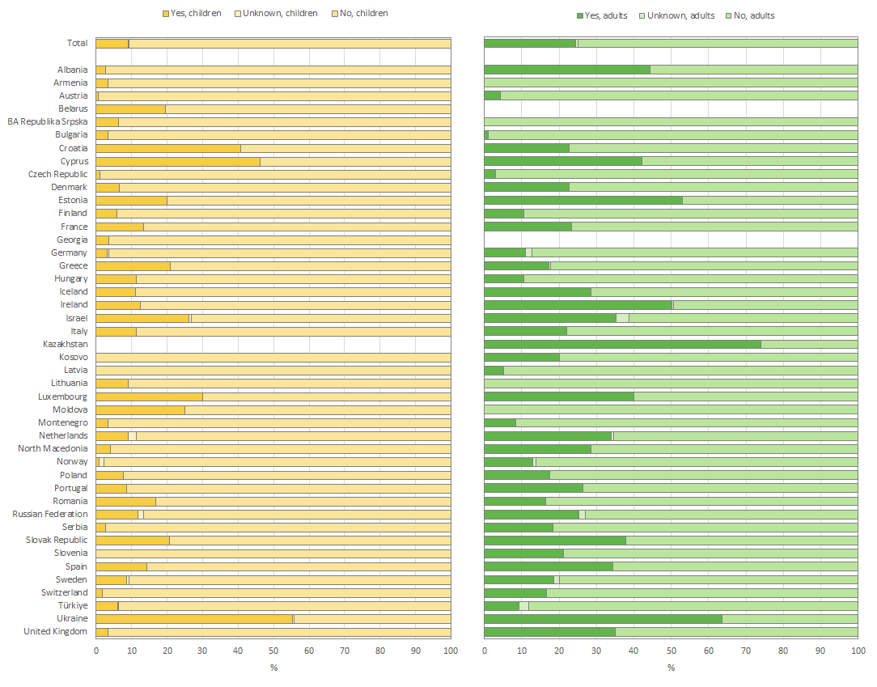
Figure 8.5
Azithromycin is used as an antibiotic and anti-inflammatory mediator throughout Europe, mostly by adults with CF.
Use of macrolides in children & adolescents (<18 years of age) and adults seen by a clinician in 2024 who have never had a transplant, by country. The graph on the left presents the data for children and that on the right presents the data for adults.
Note: Belarus and Georgia have <5 adults seen in 2024 and are excluded from the graph for adults. Oral macrolides were reimbursed in most countries except in Bulgaria, Georgia, Kazakhstan, BA-Republika Srpska and Serbia. In Armenia, they were reimbursed for some outpatients. In Kosovo in 2024 there was no system for the reimbursement of medication PwCF cover the cost of the therapy themselves.
Zolin, A., Adamoli, A., Zomer, D., Fox, A., Krasnyk, M., Lorca Mayor, S., Prasad, V., Gambazza, S., Orenti, A., Gkolia, P., Cook, E., Duckers, J., Jung, A., Laidlaw, K., Dubois, C., Kirwan, L., Krivec, U., Naehrlich, L., & Bakkeheim, E. (2026). ECFSPR 2024 Annual Data Report. Zenodo. https://doi.org/10.5281/zenodo.20085096

Slide 59
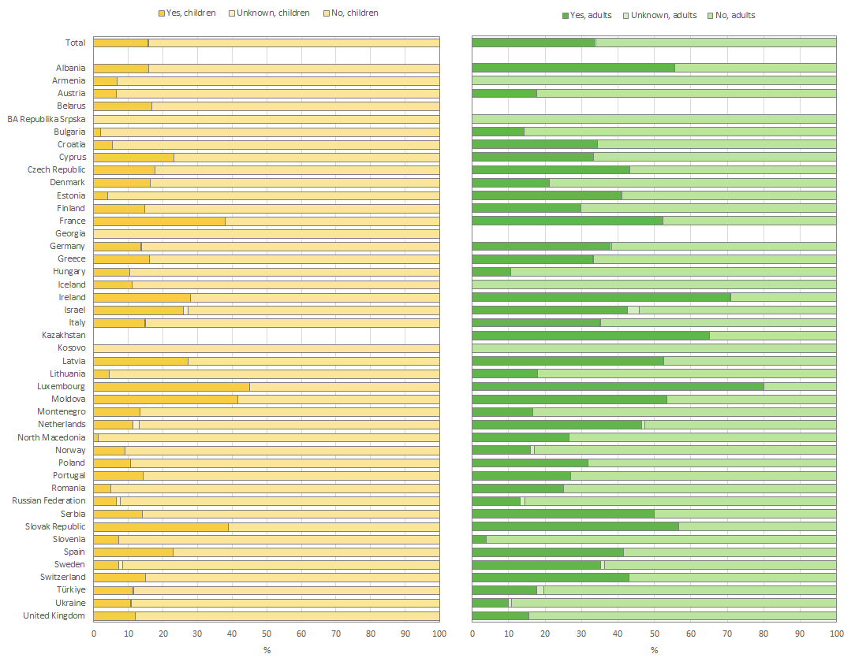
Figure 8.6
Pulmonary inflammation, including obstructive symptoms, is often treated with corticosteroids.
Use of inhaled steroids in children and adolescents (<18 years of age) and adults seen by a clinician in 2024 who have never had a transplant, by country. The graph on the left presents the data for children and that on the right presents the data for adults.
Note: Belarus and Georgia have <5 adults seen in 2024 and are excluded from the graph for adults.
Note: Inhaled steroids were reimbursed in most countries except Armenia, Georgia, Kazakhstan, Lithuania, Poland, Serbia. In Bulgaria, they were reimbursed for PwCF who were also diagnosed with asthma or chronic obstructive pulmonary disease (COPD). In Estonia, Romania and the Republic of Moldova inhaled steroids were reimbursed for PwCF who were also diagnosed with asthma. In Kosovo in 2024 there was no system for the reimbursement of medication and PwCF cover the cost of the therapy themselves.
Zolin, A., Adamoli, A., Zomer, D., Fox, A., Krasnyk, M., Lorca Mayor, S., Prasad, V., Gambazza, S., Orenti, A., Gkolia, P., Cook, E., Duckers, J., Jung, A., Laidlaw, K., Dubois, C., Kirwan, L., Krivec, U., Naehrlich, L., & Bakkeheim, E. (2026). ECFSPR 2024 Annual Data Report. Zenodo. https://doi.org/10.5281/zenodo.20085096

Slide 60
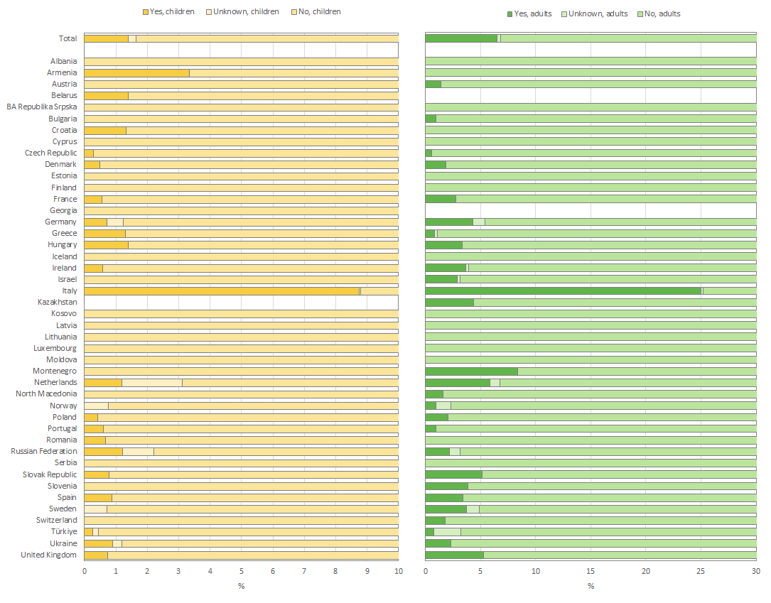
Figure 8.7
Oral steroids are prescribed less often than inhaled steroids.
Use of oral steroids in children and adolescents (<18 years of age) and adults seen by a clinician in 2024 who have never had a transplant, by country. The graph on the left presents the data for children and that on the right presents the data for adults.
Note: Information was missing for more than 10% of adults in Cyprus. Belarus and Georgia have <5 adults seen in 2024 and are excluded from the graph for adults.
Note: Oral steroids were reimbursed in most countries except in Armenia, Bulgaria, Georgia, Kazakhstan, Lithuania, the Republic of Moldova, BA-Republika Srpska and Serbia. In Kosovo in 2024 there was no system for the reimbursement of medication and PwCF cover the cost of the therapy themselves.
Zolin, A., Adamoli, A., Zomer, D., Fox, A., Krasnyk, M., Lorca Mayor, S., Prasad, V., Gambazza, S., Orenti, A., Gkolia, P., Cook, E., Duckers, J., Jung, A., Laidlaw, K., Dubois, C., Kirwan, L., Krivec, U., Naehrlich, L., & Bakkeheim, E. (2026). ECFSPR 2024 Annual Data Report. Zenodo. https://doi.org/10.5281/zenodo.20085096

Slide 61
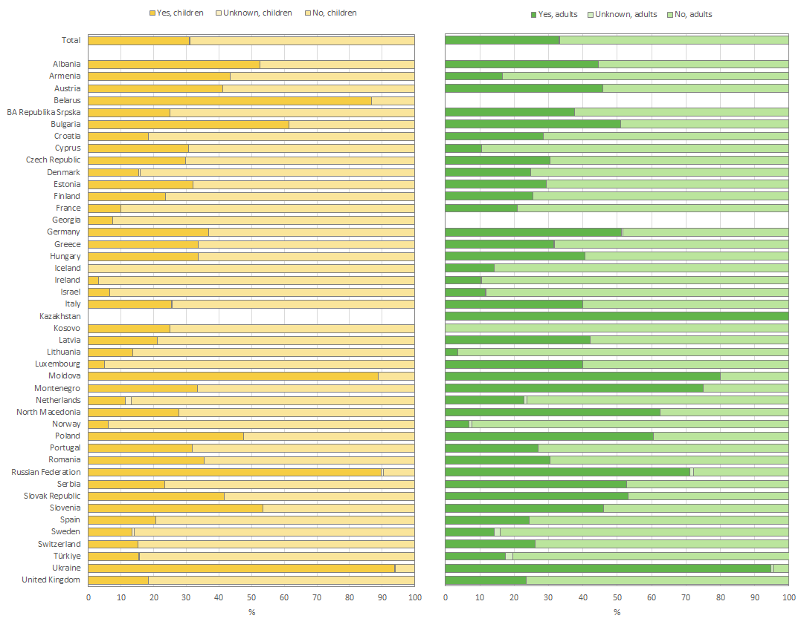
Figure 8.8
Ursodeoxycholic acid is often prescribed to treat cholestasis and liver disease in people with CF.
Use of ursodeoxycholic acid in children and adolescents (<18 years of age) and adults seen by a clinician in 2024 who have never had a transplant, by country. The graph on the left presents the data for children and that on the right presents the data for adults.
Note: Belarus and Georgia have <5 adults seen in 2024 and are excluded from the graph for adults.
Note: Oral ursodeoxycholic acid was reimbursed in most countries in Europe, except in Armenia, Bulgaria, Georgia, Lithuania and Serbia. In the Republic of Moldova it was reimbursed at 100% for children and at 70% for adults. In Kazakhstan, availability depends on the regional budget. In Kosovo in 2024 there was no system for the reimbursement of medication PwCF cover the cost of the therapy themselves.
Zolin, A., Adamoli, A., Zomer, D., Fox, A., Krasnyk, M., Lorca Mayor, S., Prasad, V., Gambazza, S., Orenti, A., Gkolia, P., Cook, E., Duckers, J., Jung, A., Laidlaw, K., Dubois, C., Kirwan, L., Krivec, U., Naehrlich, L., & Bakkeheim, E. (2026). ECFSPR 2024 Annual Data Report. Zenodo. https://doi.org/10.5281/zenodo.20085096

Slide 62
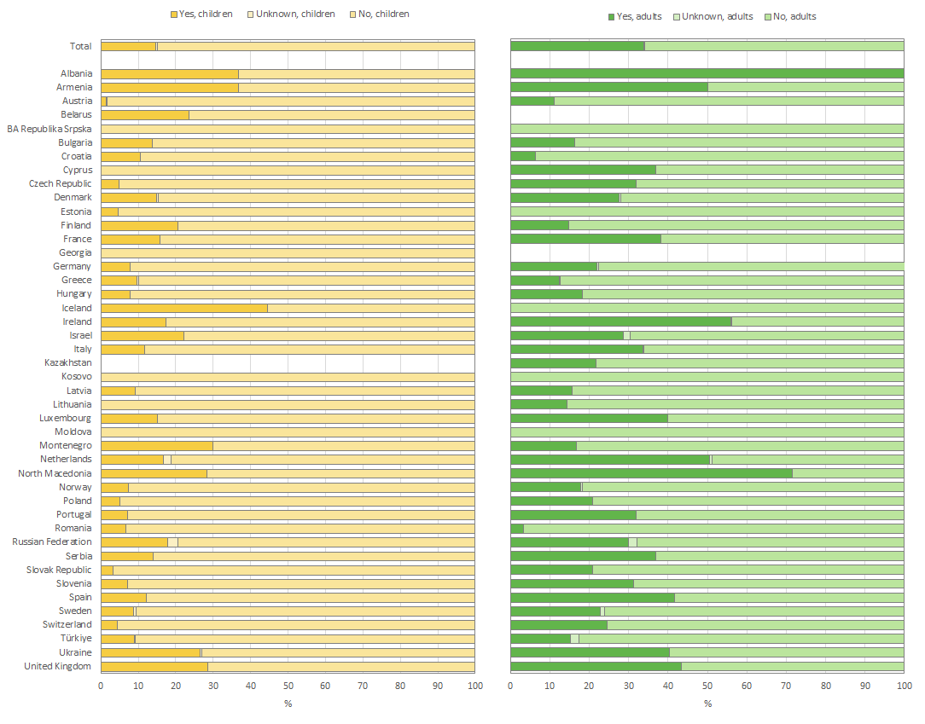
Figure 8.9
Proton Pump Inhibitors are used to treat gastroesophageal reflux and gastritis, both common complications in CF, and to enhance pancreatic enzyme efficacy.
Use of proton pump inhibitors (PPI) in children and adolescent (<18 years of age) and adults seen by a clinician in 2024 who have never had a transplant, by country. The graph on the left presents the data for children and that on the right presents the data for adults.
Note: Information was missing for more than 10% of adults in Republic of Moldova. Belarus and Georgia have <5 adults seen in 2024 and are excluded from the graph for adults.
Note: Oral proton pump inhibitors were reimbursed in most countries except in Bulgaria, Georgia, Kazakhstan, Lithuania and Serbia. In Armenia they were reimbursed for some outpatients. In Kosovo in 2024 there was no system for the reimbursement of medication PwCF cover the cost of the therapy themselves.
Zolin, A., Adamoli, A., Zomer, D., Fox, A., Krasnyk, M., Lorca Mayor, S., Prasad, V., Gambazza, S., Orenti, A., Gkolia, P., Cook, E., Duckers, J., Jung, A., Laidlaw, K., Dubois, C., Kirwan, L., Krivec, U., Naehrlich, L., & Bakkeheim, E. (2026). ECFSPR 2024 Annual Data Report. Zenodo. https://doi.org/10.5281/zenodo.20085096

Slide 63
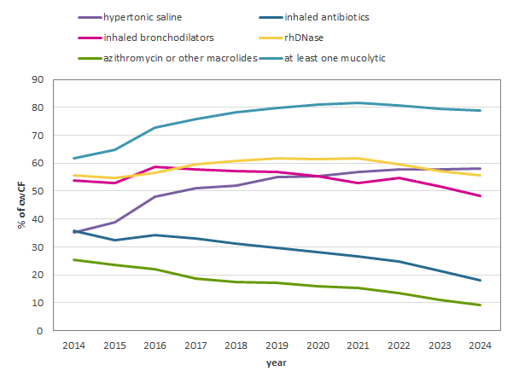
Figure 8.10
The increased use of CFTR modulators in children with CF in Europe goes hand in hand with a decrease in the prescription of azithromycin and inhaled antibiotics, while that of inhaled mucolytics remains mostly unchanged.
Therapy use in children and adolescents (<18 years of age) between 2014 and 2024.
Zolin, A., Adamoli, A., Zomer, D., Fox, A., Krasnyk, M., Lorca Mayor, S., Prasad, V., Gambazza, S., Orenti, A., Gkolia, P., Cook, E., Duckers, J., Jung, A., Laidlaw, K., Dubois, C., Kirwan, L., Krivec, U., Naehrlich, L., & Bakkeheim, E. (2026). ECFSPR 2024 Annual Data Report. Zenodo. https://doi.org/10.5281/zenodo.20085096

Slide 64
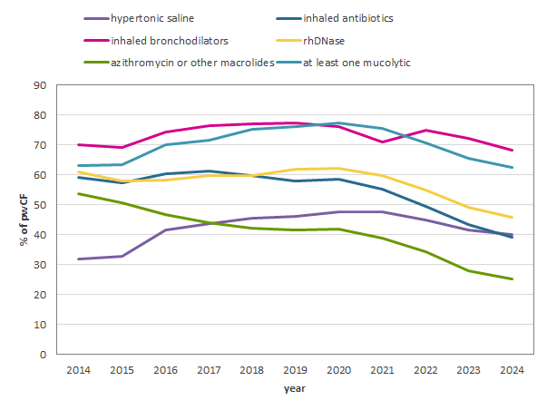
Figure 8.11
The increased use of CFTR modulators in adults with CF in Europe goes hand in hand with a decrease in the prescription of azithromycin and inhaled antibiotics, inhaled antibiotics and inhaled mucolytics.
Therapy use in adults between 2014 and 2024.
Zolin, A., Adamoli, A., Zomer, D., Fox, A., Krasnyk, M., Lorca Mayor, S., Prasad, V., Gambazza, S., Orenti, A., Gkolia, P., Cook, E., Duckers, J., Jung, A., Laidlaw, K., Dubois, C., Kirwan, L., Krivec, U., Naehrlich, L., & Bakkeheim, E. (2026). ECFSPR 2024 Annual Data Report. Zenodo. https://doi.org/10.5281/zenodo.20085096

Slide 65
CHAPTER 9 CFTR MODULATOR THERAPIES
https://pr.ecfs.eu/

Slide 66
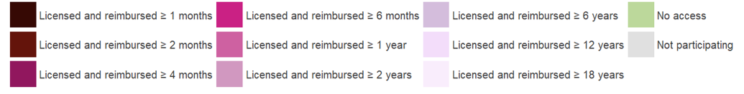
Figure 9.1
Countries where ivacaftor was licensed and reimbursed in 2024.
Note: Norway – ivacaftor was reimbursed for children with CF if weight ≥5kg. United Kingdom – ivacaftor was reimbursed for people with CF with the variant R117H who were ≥6 months old. BA-Bosnia-Herzegovina: shown as "not participating" because the data were missing for 2024. Hungary: the information reported is the same as for 2023 because the data were missing for 2024.
Zolin, A., Adamoli, A., Zomer, D., Fox, A., Krasnyk, M., Lorca Mayor, S., Prasad, V., Gambazza, S., Orenti, A., Gkolia, P., Cook, E., Duckers, J., Jung, A., Laidlaw, K., Dubois, C., Kirwan, L., Krivec, U., Naehrlich, L., & Bakkeheim, E. (2026). ECFSPR 2024 Annual Data Report. Zenodo. https://doi.org/10.5281/zenodo.20085096

Slide 67
Figure 9.2
Countries where lumacaftor/ivacaftor was licensed and reimbursed in 2024.
Note: France: ≥ 1 year from April 2024. Hungary: ≥ 1 year (F508 homozygous) from July 2023.
Note: BA-Bosnia-Herzegovina: shown as "not participating" because the data were missing for 2024. Hungary: the information reported is the same as for 2023 because the data were missing for 2024.
Zolin, A., Adamoli, A., Zomer, D., Fox, A., Krasnyk, M., Lorca Mayor, S., Prasad, V., Gambazza, S., Orenti, A., Gkolia, P., Cook, E., Duckers, J., Jung, A., Laidlaw, K., Dubois, C., Kirwan, L., Krivec, U., Naehrlich, L., & Bakkeheim, E. (2026). ECFSPR 2024 Annual Data Report. Zenodo. https://doi.org/10.5281/zenodo.20085096

Slide 68
Figure 9.3
Countries where tezacaftor/ivacaftor was licensed and reimbursed in year 2024.
Note: BA-Bosnia-Herzegovina: shown as "not participating" because the data were missing for 2024.
Zolin, A., Adamoli, A., Zomer, D., Fox, A., Krasnyk, M., Lorca Mayor, S., Prasad, V., Gambazza, S., Orenti, A., Gkolia, P., Cook, E., Duckers, J., Jung, A., Laidlaw, K., Dubois, C., Kirwan, L., Krivec, U., Naehrlich, L., & Bakkeheim, E. (2026). ECFSPR 2024 Annual Data Report. Zenodo. https://doi.org/10.5281/zenodo.20085096

Slide 69

Figure 9.4
Countries where elexacaftor/tezacaftor/ivacaftor is licensed and reimbursed in year 2024.
Note: Czech Republic: individual reimbursement system for 2-5 years old. Hungary: ≥ 2 years old with at least one F508 mutation from March 2024. Lithuania: ≥ 2 years old from October 2024. Norway: ≥ 2 years old from July 2024. Romania: ≥ 2 years old from December 2024. Spain: ≥ 2 years old from August 2024. Sweden: ≥ 2 years old from February 2024. France: 2-5 years old from September 2023 (early access program).
Note: BA-Bosnia-Herzegovina: shown as "not participating" because the data were missing for 2024.
Zolin, A., Adamoli, A., Zomer, D., Fox, A., Krasnyk, M., Lorca Mayor, S., Prasad, V., Gambazza, S., Orenti, A., Gkolia, P., Cook, E., Duckers, J., Jung, A., Laidlaw, K., Dubois, C., Kirwan, L., Krivec, U., Naehrlich, L., & Bakkeheim, E. (2026). ECFSPR 2024 Annual Data Report. Zenodo. https://doi.org/10.5281/zenodo.20085096

Slide 70
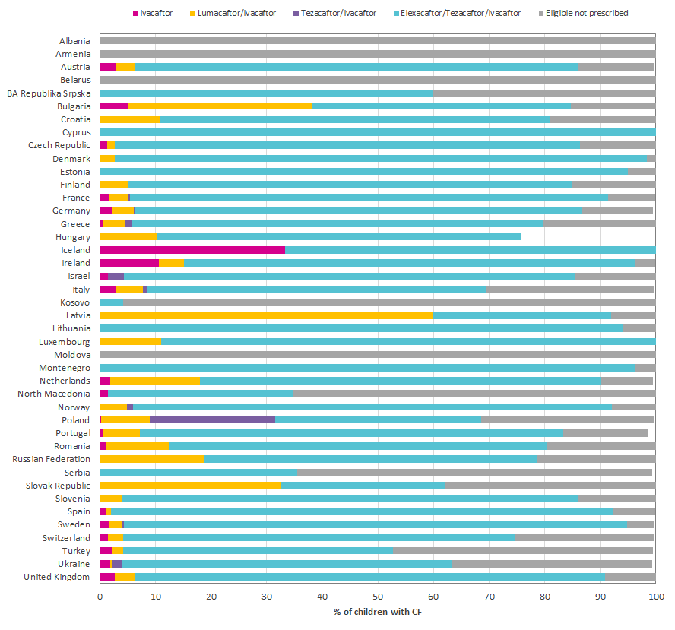
Figure 9.5
Elexacaftor/tezacaftor/ivacaftor is the CFTR modulator most commonly used in children, followed by lumacaftor/ivacaftor.
Children and adolescents with CF (<18 years), eligible for and treated with at least one modulator, by country and last CFTR modulator prescribed, seen by a clinician in 2024 and who have never had a transplant.
Note: Georgia has <5 elegible children seen in 2024 and are excluded from the graph.
Zolin, A., Adamoli, A., Zomer, D., Fox, A., Krasnyk, M., Lorca Mayor, S., Prasad, V., Gambazza, S., Orenti, A., Gkolia, P., Cook, E., Duckers, J., Jung, A., Laidlaw, K., Dubois, C., Kirwan, L., Krivec, U., Naehrlich, L., & Bakkeheim, E. (2026). ECFSPR 2024 Annual Data Report. Zenodo. https://doi.org/10.5281/zenodo.20085096

Slide 71
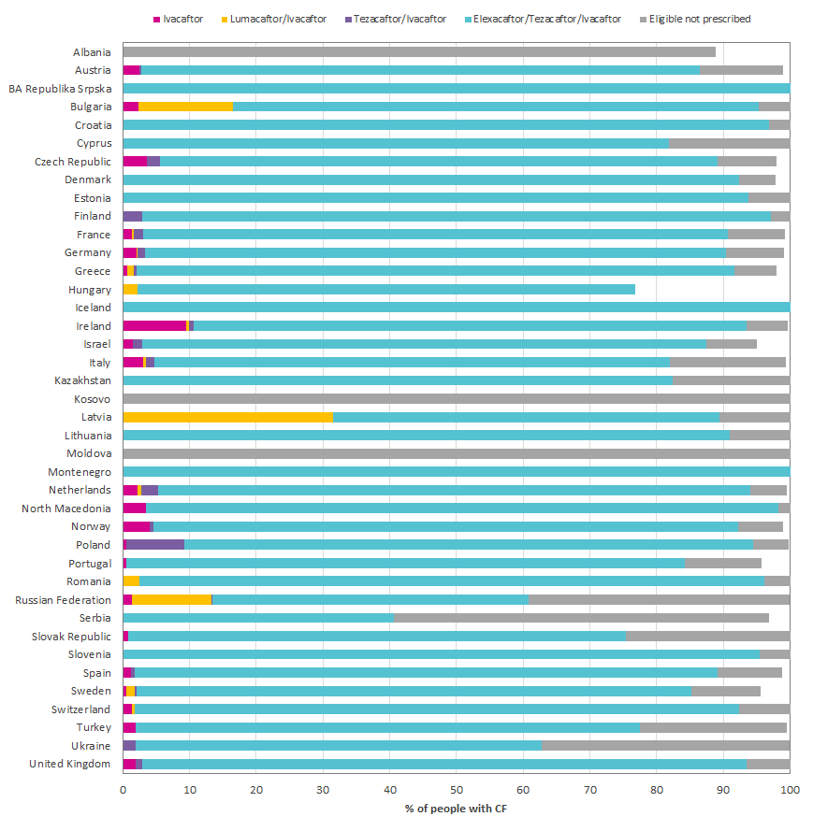
Figure 9.6
Elexacaftor/tezacaftor/ivacaftor is the CFTR modulator most commonly used in adults.
Adults with CF (≥18 years), eligible for at least one modulator, by country and last CFTR modulator prescribed, seen by a clinician in 2024 and who have never had a transplant.
Note: Armenia, Belarus, Georgia and Luxembourg have <5 eligible adults seen in 2024 and are excluded from the graph.
Zolin, A., Adamoli, A., Zomer, D., Fox, A., Krasnyk, M., Lorca Mayor, S., Prasad, V., Gambazza, S., Orenti, A., Gkolia, P., Cook, E., Duckers, J., Jung, A., Laidlaw, K., Dubois, C., Kirwan, L., Krivec, U., Naehrlich, L., & Bakkeheim, E. (2026). ECFSPR 2024 Annual Data Report. Zenodo. https://doi.org/10.5281/zenodo.20085096

Slide 72

Figure 9.7
With expansion of the eligibility criteria and a more extensive reimbursement programme for CFTR modulators in many of the countries in the ECFSPR there has been a considerable increase in their use since 2020.
Use of CFTR modulator therapy from 2018 to 2024.
In this graph we present data over time using cross sectional data per year of people with a confirmed CF diagnosis. All people with CF alive, deceased or not seen during the year of follow-up were included.
Zolin, A., Adamoli, A., Zomer, D., Fox, A., Krasnyk, M., Lorca Mayor, S., Prasad, V., Gambazza, S., Orenti, A., Gkolia, P., Cook, E., Duckers, J., Jung, A., Laidlaw, K., Dubois, C., Kirwan, L., Krivec, U., Naehrlich, L., & Bakkeheim, E. (2026). ECFSPR 2024 Annual Data Report. Zenodo. https://doi.org/10.5281/zenodo.20085096

Slide 73
CHAPTER 10 PREGNANCY
https://pr.ecfs.eu/

Slide 74
Table 10.1
Pregnancy and pregnancy outcomes in women with CF (≥16 years) seen in 2024 who have never had a transplant.
Pregnancy and outcome | Number | Percentage
Pregnant, don’t know if stopped during the year | 13 | 0.1
Pregnant, ongoing at the end of 2024 | 263 | 1.8
Pregnant, stopped during the year | 482 | 3.3
Pregnancy outcome:
Live birth | 375 | 77.8
Spontaneous abortion (<28weeks) | 39 | 8.1
Still birth (≥28weeks) | 3 | 0.6
Therapeutic abortion for medical reasons | 15 | 3.1
Other | 18 | 3.7
Missing/Unknown | 32 | 6.6
Not Pregnant | 13538 | 93.8
Missing/Unknown | 133 | 0.9
Zolin, A., Adamoli, A., Zomer, D., Fox, A., Krasnyk, M., Lorca Mayor, S., Prasad, V., Gambazza, S., Orenti, A., Gkolia, P., Cook, E., Duckers, J., Jung, A., Laidlaw, K., Dubois, C., Kirwan, L., Krivec, U., Naehrlich, L., & Bakkeheim, E. (2026). ECFSPR 2024 Annual Data Report. Zenodo. https://doi.org/10.5281/zenodo.20085096

Slide 75
Table 10.2
Pregnancy and pregnancy outcomes in women with CF (≥16 years) seen in 2023 who have never had a transplant.
Pregnancy and outcome | Number | Percentage
Pregnant, ongoing at the end of 2023 | 247 | 1.8
Pregnant, stopped during the year | 501 | 3.6
Pregnancy outcome:
Live birth | 410 | 81.8
Spontaneous abortion (<28weeks) | 47 | 9.4
Still birth (≥28weeks) | 1 | 0.2
Therapeutic abortion for medical reasons | 26 | 5.2
Other | 8 | 1.6
Missing/Unknown | 9 | 1.8
Not pregnant | 12566 | 91.0
Missing/Unknown | 495 | 3.6
Zolin, A., Adamoli, A., Zomer, D., Fox, A., Krasnyk, M., Lorca Mayor, S., Prasad, V., Gambazza, S., Orenti, A., Gkolia, P., Cook, E., Duckers, J., Jung, A., Laidlaw, K., Dubois, C., Kirwan, L., Krivec, U., Naehrlich, L., & Bakkeheim, E. (2026). ECFSPR 2024 Annual Data Report. Zenodo. https://doi.org/10.5281/zenodo.20085096

Slide 76
CHAPTER 11 LUNG & OTHER ORGAN TRANSPLANTS
https://pr.ecfs.eu/

Slide 77

Figure 11.1
The number and proportion of people with CF living with transplanted lung/s is heterogenous across Europe.
Number of people with CF living in 2024 with transplanted lungs, by country.
This graph shows the number of people with CF alive at 31/12/2024 who have had a lung transplant (light turquoise bars) at some point in their life. The pink dots (right axis) show the percentage of people that were living with transplanted lung in 2024 out of all people with CF that were seen by a clinician in 2024.
Zolin, A., Adamoli, A., Zomer, D., Fox, A., Krasnyk, M., Lorca Mayor, S., Prasad, V., Gambazza, S., Orenti, A., Gkolia, P., Cook, E., Duckers, J., Jung, A., Laidlaw, K., Dubois, C., Kirwan, L., Krivec, U., Naehrlich, L., & Bakkeheim, E. (2026). ECFSPR 2024 Annual Data Report. Zenodo. https://doi.org/10.5281/zenodo.20085096

Slide 78

Figure 11.2
The number and proportion of people with CF living with a liver transplant is extremely heterogenous throughout Europe.
Number of people with CF living in 2024 with transplanted liver, by country.
This graph shows the number of people with CF alive at 31/12/2024 who have had a liver transplant (light turquoise bars) at some point in their life. The pink dots (right axis) show the percentage of people living with transplanted liver in 2024 out of all people with CF that were seen in 2024. Note that (left vertical axis) the number of people who have had a liver transplant is much lower than the number of people with transplanted lungs. The main reason for this is that liver disease is only found in a subset of people with CF, whereas lung disease affects almost all people with CF.
Zolin, A., Adamoli, A., Zomer, D., Fox, A., Krasnyk, M., Lorca Mayor, S., Prasad, V., Gambazza, S., Orenti, A., Gkolia, P., Cook, E., Duckers, J., Jung, A., Laidlaw, K., Dubois, C., Kirwan, L., Krivec, U., Naehrlich, L., & Bakkeheim, E. (2026). ECFSPR 2024 Annual Data Report. Zenodo. https://doi.org/10.5281/zenodo.20085096

Slide 79
CHAPTER 12 MORTALITY
https://pr.ecfs.eu/

Slide 80

Figure 12.1
Most of the deaths occur between the third and the fifth decade of life in people with CF in Europe.
Age at death distribution of people with CF deceased in 2024, by sex.
This graph shows the distribution of age at death of people with CF who died in 2024, separated by males (blue) and females (red).
Zolin, A., Adamoli, A., Zomer, D., Fox, A., Krasnyk, M., Lorca Mayor, S., Prasad, V., Gambazza, S., Orenti, A., Gkolia, P., Cook, E., Duckers, J., Jung, A., Laidlaw, K., Dubois, C., Kirwan, L., Krivec, U., Naehrlich, L., & Bakkeheim, E. (2026). ECFSPR 2024 Annual Data Report. Zenodo. https://doi.org/10.5281/zenodo.20085096

Slide 81

Figure 12.2
In the last decade the proportion of PwCF deceased in a year relative to the total number of PwCF in the year has decreased throughout Europe.
PwCF deceased as a percentage of all PwCF in the years from 2014 to 2024.
In this graph data over time are presented using cross sectional data per year. People with CF who are alive, deceased, or not seen during the year of follow-up were included and those who were lost to follow-up were excluded.
Zolin, A., Adamoli, A., Zomer, D., Fox, A., Krasnyk, M., Lorca Mayor, S., Prasad, V., Gambazza, S., Orenti, A., Gkolia, P., Cook, E., Duckers, J., Jung, A., Laidlaw, K., Dubois, C., Kirwan, L., Krivec, U., Naehrlich, L., & Bakkeheim, E. (2026). ECFSPR 2024 Annual Data Report. Zenodo. https://doi.org/10.5281/zenodo.20085096

Slide 82
CHAPTER 13 DATA QUALITY
https://pr.ecfs.eu/

Slide 83

Figure 13.1
The overall completeness of data for all variables from the countries participating in the ECFSPR in 2024 is 99%.
Completeness of the data in 2024, for all pwCF seen by a clinician, in all participating countries, overall percentages by variable.
Note: Completeness for FEV1 is evaluated only for individuals with CF ≥ 6 years.
Note: Completeness for BMI is evaluated only for individuals with CF ≥ 2 years.
Zolin, A., Adamoli, A., Zomer, D., Fox, A., Krasnyk, M., Lorca Mayor, S., Prasad, V., Gambazza, S., Orenti, A., Gkolia, P., Cook, E., Duckers, J., Jung, A., Laidlaw, K., Dubois, C., Kirwan, L., Krivec, U., Naehrlich, L., & Bakkeheim, E. (2026). ECFSPR 2024 Annual Data Report. Zenodo. https://doi.org/10.5281/zenodo.20085096

Slide 84

Figure 13.2
The validated clinical data amounts to 4% of the pwCF in these countries from 2023 and 2024.
Data accuracy for the follow-up years 2023 and 2024 in the countries visited, overall percentages by variable.
We validated data (from 2023 and 2024) for 4% of the PwCF from 15 countries. Eight countries with established national CF registries (France, Germany, Ireland, Italy, the Netherlands, Sweden, Türkiye and United Kingdom) have their own internal data validation programme and they provided us with the results presented in this report.
Zolin, A., Adamoli, A., Zomer, D., Fox, A., Krasnyk, M., Lorca Mayor, S., Prasad, V., Gambazza, S., Orenti, A., Gkolia, P., Cook, E., Duckers, J., Jung, A., Laidlaw, K., Dubois, C., Kirwan, L., Krivec, U., Naehrlich, L., & Bakkeheim, E. (2026). ECFSPR 2024 Annual Data Report. Zenodo. https://doi.org/10.5281/zenodo.20085096

